Slide 1
Waste Management in SED Activity
Prof. Dr. Olga Popova

Slide 2
N
A
T
U
R
A
l
R
E
S
O
U
R
S
E
the Reproduction Cycle
Production process
Commercial process
P
R
O
D
U
C
T
I
O
N
DI
ST
RI
BU
TI
ON
E
X
C
H
A
N
G
E
CO
NS
UM
PT
IO
N
Production Resources
Industrial Wastes
Goods
Commerce
Wastes
Consumer
Wastes
Waste Management Process
WASTES
Real recoverable resources
Potential recoverable resources
Disposal of Waste, Conservation
Recourse Flows
Potential Recourse Fows

Slide 3
Waste is an unavoidable by-product of most human activity.
Waste includes all items that people no longer have any use for, which they either intend to get rid of or have already discarded.

Slide 4
“The most dangerous kind of waste is the waste we do not recognize”
Shigeo Shingo (1909 - 1990), a Japanese industrial engineer who is considered as the world’s leading expert on manufacturing practices and the Toyota Production System

Slide 5
Benefits
Type of benefits
Economic | Improving economic efficiency through the means of resource use, treatment and disposal and creating markets for recycles can lead to efficient practices in the production and consumption of products and materials resulting in valuable materials being recovered for reuse and the potential for new jobs and new business opportunities.
Social | By reducing adverse impacts on health by proper waste management practices, the resulting consequences are more appealing settlements. Better social advantages can lead to new sources of employment and potentially lifting communities out of poverty especially in some of the developing poorer countries and cities.
Environmental | Reducing or eliminating adverse impacts on the environmental through reducing, reusing and recycling, and minimizing resource extraction can provide improved air and water quality and help in the reduction of greenhouse emissions.
Inter-generational Equity | Following effective waste management practices can provide subsequent generations a more robust economy, a fairer and more inclusive society and a cleaner environment

Slide 6
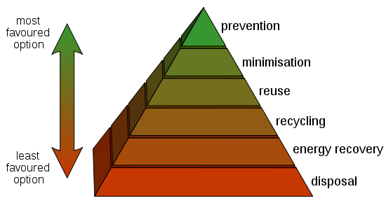
The waste hierarchy refers to the "3 Rs"
REDUCE
REUSE
RECYCLE which classify waste management strategies according to their desirability. The 3 Rs are meant to be a hierarchy, in order of importance

Slide 7
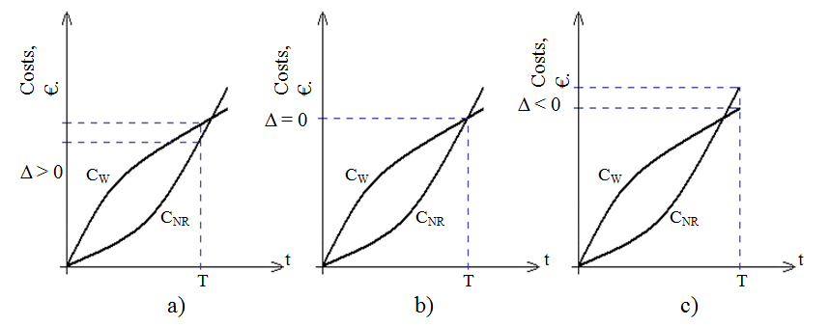
Сonditions of efficient use of waste

Slide 8
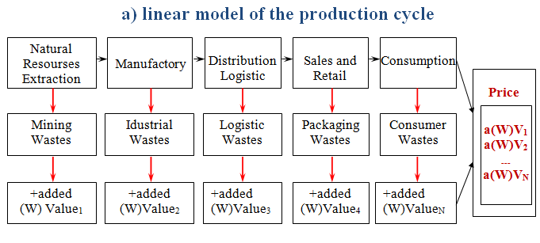

Slide 9
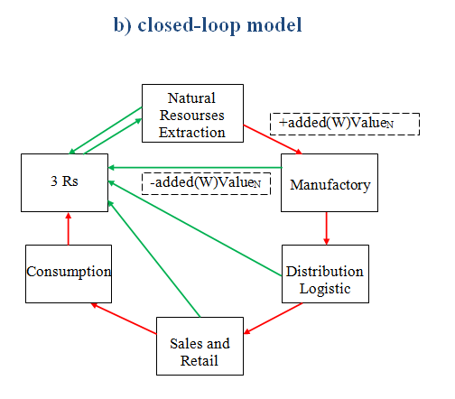
will provide additional jobs,
help close the material loop,
reduce dependency on imports,
reduce the environmental impact associated with waste disposal,
drive innovation in product design

Slide 10



the film Mobiusa

Slide 11


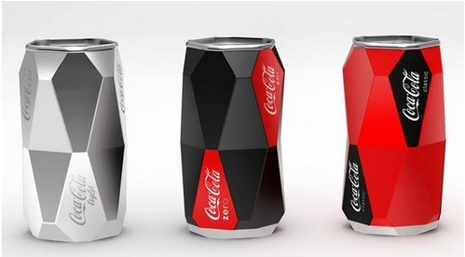
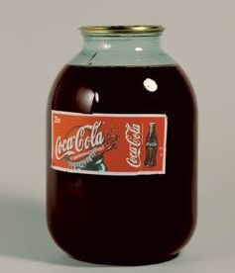
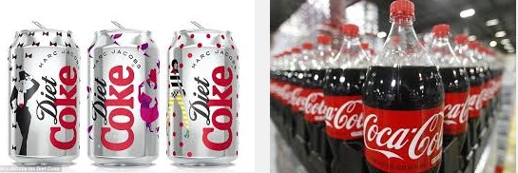

Slide 12


Slide 13
Zero Waste is a philosophy, a strategy, and a set of practical tools seeking to eliminate waste, not manage it
The waste hierarchy refers to the “5 Rs"
REFUSE (buying only what you need)
REDUCE (no to excessive packaging, disposable or single-use items)
REUSE (creative use)
RECYCLE (save the value)
RECOVER (There is no such thing as waste. There are only wasted
resources.)

Slide 14
Principles Guiding of Current Practices and for Pursuing Zero Waste*
 | Principles Guiding Current Practices | Guiding Principles for Pursuing Zero Waste
System-wide Principles | •Limitless flow of resources from nature to dumps. • Lack of producer responsibility for environmental and social impacts of products and packaging. • Focus on increasing production and productivity of labor. • Focus on large-scale, centralized, capital-intensive industries (resource extraction and waste management). • Many environmental costs and benefits not accounted for. | •Flow of resources viewed as a cycle with minimized input and output. • Responsibility by producers for the life-cycle impacts of products and packaging, creating incentive to design more benign products. • Focus on increasing benefits to communities and optimizing productive use of resources. • Focus on locally owned, independent industries. • Accounting for environmental costs and benefits.
Govern-ment Policies | •Manage waste at taxpayer expense. • Regulate specific environmental emissions at facilities. • Subsidize virgin extraction firms and waste management firms | •Eliminate waste by holding producers responsible for impact. • Systematically optimize environmental, economic and social impacts of the production and consumption cycle. • Create level playing field or outright subsidies to promote resource conservation industries.

Slide 15
 | Principles Guiding Current Practices | Guiding Principles for Pursuing Zero Waste
Raw Material Supply | • Emphasis on virgin resources with harvests determined by commodity cycles. • Toxic materials managed. | • Emphasis on recycled material use and sustainable harvesting of natural resources. • Emphasis on use of non-toxic materials
Product and Packaging Design | • Guided by competitive innovation, with emphasis on marketing and sales. • Some attention to design-for-recycling, clean production, or design-for-environment where public attention is focused. • Focus on short product lifespans to maximize sales. | • Guided by design-for-environment principles to reduce resource use and environmental emissions, and to minimize recycling or reuse costs. • Focus on waste minimization, durability, repairability, and recyclability. • Maximized lifespans of products.

Slide 16
 | Principles Guiding Current Practices | Guiding Principles for Pursuing Zero Waste
Manufacturing Practices | Companies strive to minimize compliance costs with end-of-pipe emission regulations. | • Companies redesign entire operations to minimize resource use and environmental emissions and maximize product reuse and recycling. • Producing companies are responsible for end-of-life management of their products and packaging. • Producers influence Zero Waste throughout the system by adjusting specifications for suppliers and by taking responsibility for end-of-life management
Sales and Distribution | • Wholesalers and retailers assume no responsibility for environmental management. • Emphasis on large-scale distribution and international trade. | • Where feasible, products are leased, with ownership retained by the producer. • Wholesalers and retailers are active partners in product take-back and marketing environmentally sound products. • Emphasis on regional distribution and sales

Slide 17
 | Principles Guiding Current Practices | Guiding Principles for Pursuing Zero Waste
Consumption | • Consumers select products based on price and quality | • Consumers select products based on environmental performance, price, and quality. • Consumers participate in recycling and reuse programs.
End-of-Life Management | • Many environmental costs and benefits hidden. • Secretive and complicated accounting processes. • Taxpayers bear most costs of disposal, including landfilling and recycling. | • Programs create strong incentive to maximize diversion. • Programs incorporate full cost accounting principles. • Producers bear most costs of disposal.
*http://archive.grrn.org/zerowaste/kit/briefing/principles1.pdf

Slide 18
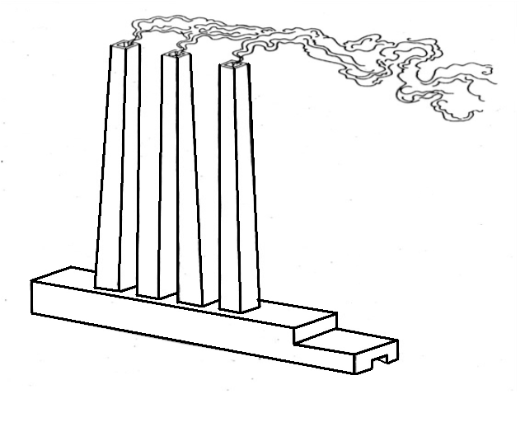
How many filters must be installed?

Slide 19

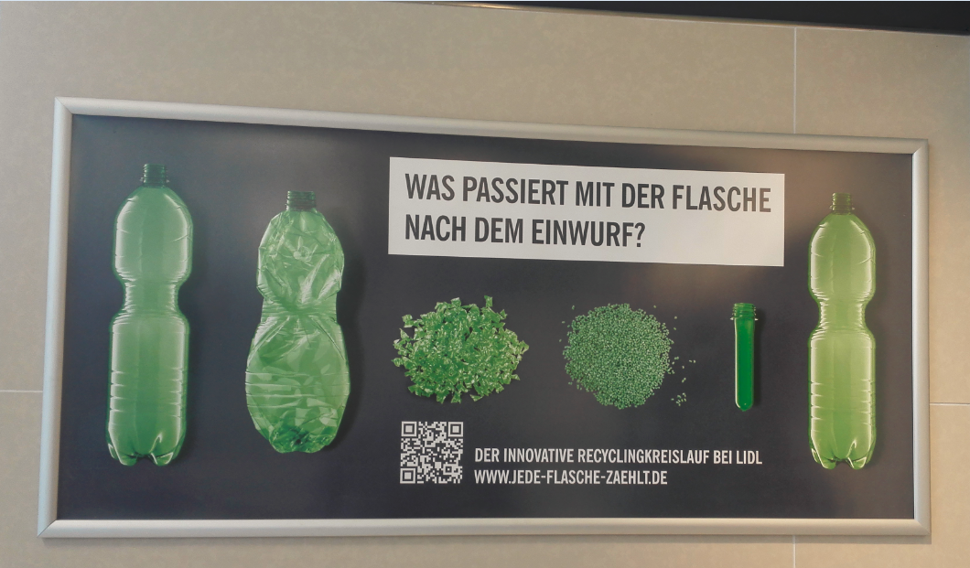

Slide 20
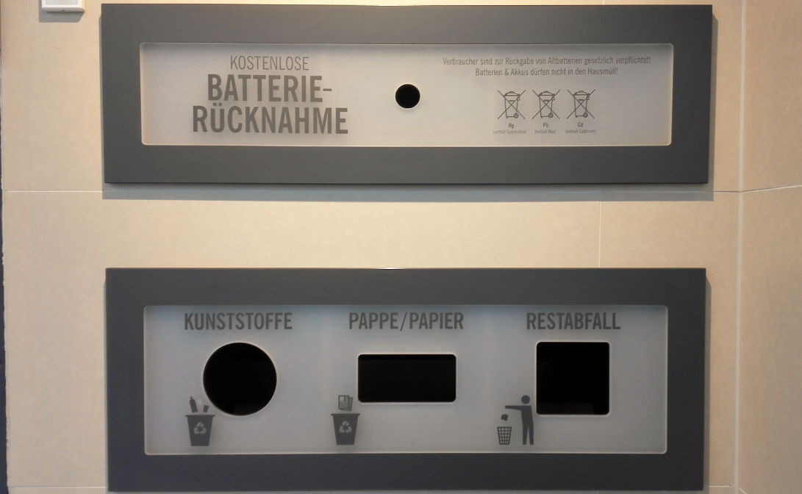

Slide 21

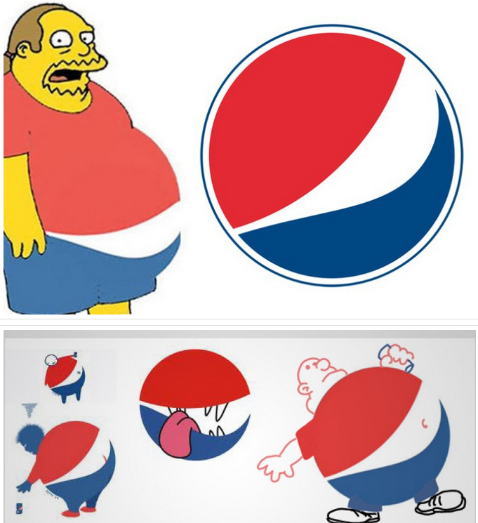
Value – 1 mill. $
http://www.pure-t.ru/2016/05/01/%D1%82%D0%BE%D0%BF-7-%D1%81%D0%B0%D0%BC%D1%8B%D1%85-%D0%B4%D0%BE%D1%80%D0%BE%D0%B3%D0%B8%D1%85-%D0%B8-%D0%BD%D0%B5%D1%83%D0%B4%D0%B0%D1%87%D0%BD%D1%8B%D1%85-%D1%81%D0%BC%D0%B5%D0%BD-%D0%BB%D0%BE%D0%B3/

Slide 22

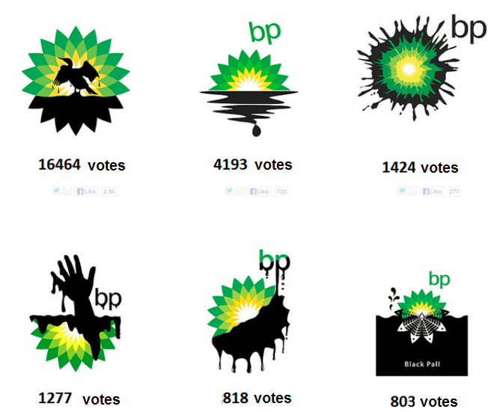
Value – 211 mill. $

