Slide 1
Introduction in Theory of Sustainable Enterprise
Prof. Dr. Olga Popova

Slide 2
Enterprise: what is it?
Enterprises – from micro-enterprises, through to small, medium-sized and large companies – are the principal source of economic growth and employment creation and are at the heart of economic activity and development in nearly all countries. Growth is fuelled first and foremost by the creativity and hard work of entrepreneurs and workers. Driven by the quest for profits, enterprises innovate, invest and generate employment and wage income. Their contribution to the generation of employment varies from country to country, but overall, private enterprises generate the majority of jobs, creating opportunities for people to acquire knowledge, to apply their skills and talents, and to improve their well-being. Enterprises provide the goods and services needed by everyone from consumer goods through to health care, food and shelter. Enterprises are a major – often the main – source of tax revenues and therefore typically constitute the foundation on which public provision of health, education and other services rests.

Slide 3
Some history
In the 20th century, the world built a spectacular engine for economic growth, which delivered incredible, if deeply uneven, prosperity. Four key factors drove this engine:
1. New technologies, especially those associated with the "second industrial revolution," from the 1920s to the 1960s, across much of the OECD;
2. Expanded labor inputs as a result of growth in the working-age population and higher female participation in the workforce;
3. Urbanization, which acts as an accelerator for technological modernization and productivity growth:
4. Increased use of resources: materials, water, land, energy and other forms of (largely unpriced) natural capital.
Throughout history, great challenges have inspired great, transformative leadership. And what could be a greater challenge than building a model of economic growth that can deliver both widespread prosperity and good planetary stewardship?
What follows is a roadmap that describes how to get to a more regenerative, more inclusive system of ECONOMIC GROWTH.

Slide 4
The world science actively began to engage in research on the sustainable development of the 80-ies of XX century. The conception of sustainable development was proposed in 1987 by a group of scientists headed by the Prime Minister of Norway Gro Harlem Brundtland and acquired popularity after United Nations Conference on Environment & Development (1992, Rio de Janeiro), on its results it was highlighted three areas that determine priorities of sustainable development :
– Environmental protection;
– Protection of the human genome and its health;
– The creation of social, economic, political and other mechanisms to ensure;
– Solving problems concerning the environment and human health.
In this area sustainable development was defined as development that satisfies needs of nowadays and doesn’t threaten the future generations’ opportunities to satisfy their own needs

Slide 5
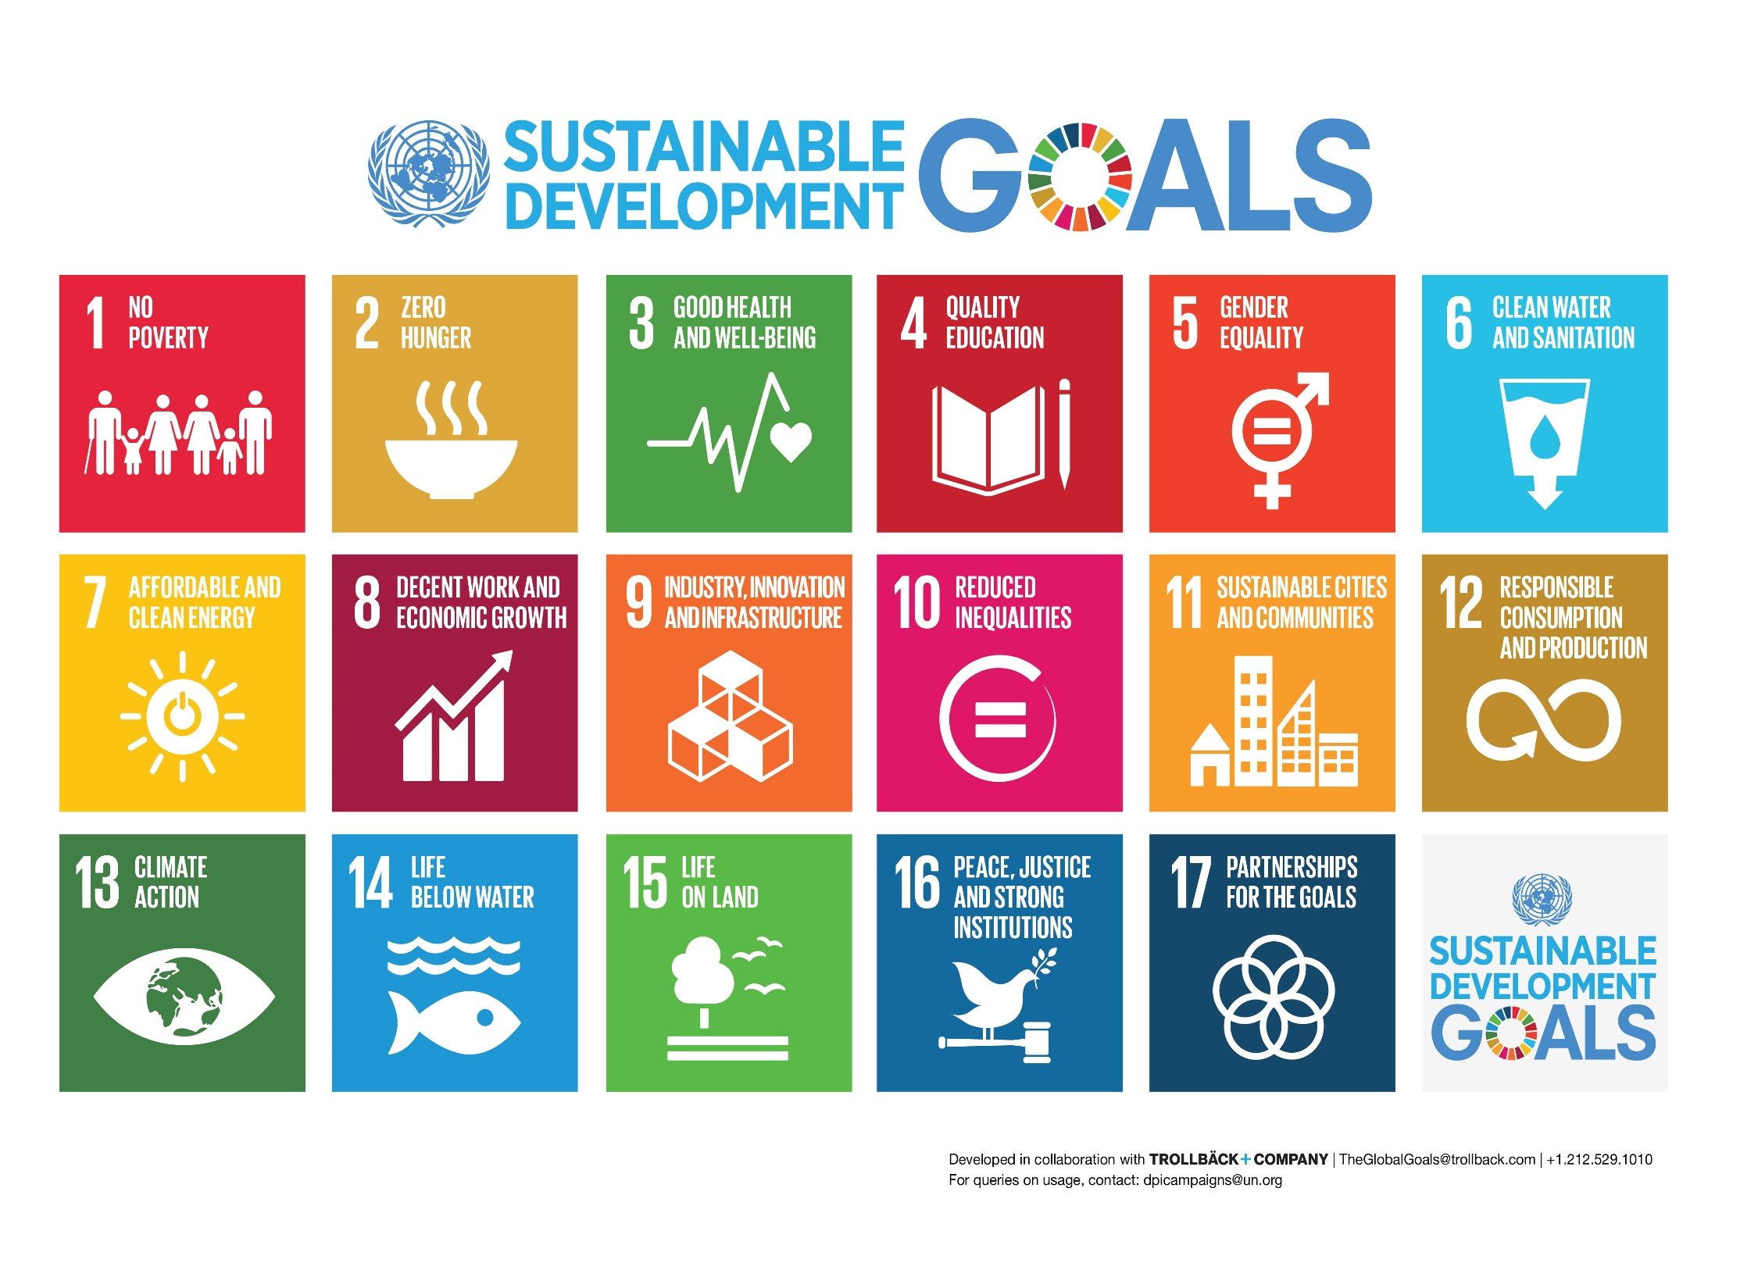

Slide 6
The concept of "sustainability" is complex and multifaceted
− In the philosophy "sustainability" is considered as a characteristic of the state of motion and development of matter. At the same time, only forms of matter have a right to exist, which are characterized by stable form of motion. In unstable motion material substances are destroyed as a result of stochastic effects of external and internal factors;
− In technology "sustainability" is understood as the object characteristic to perform the necessary functions during a given vibration and to keep values of parameters, within standards;
− In environmental "sustainability" is interpreted as "the ability of the ecosystem to maintain its structure and functional properties by external factors";
− In cybernetics is seen as an ability to keep constancy of some invariant system within process of state system change. A number of researchers attempted to calculate the sustainability, as a result of the following methods of analysis of linear stationary dynamic system for stability were created: absolute stability criterion, Mikhailov stability criterion, Nyquist criterion and the Nyquist diagram, Hurwitz stability criterion, Routh stability criterion;
− In automatic control theory – stability is characterized by the response of the dynamic system to external influence;
− In calculus mathematics stability shows how the algorithm is associated with errors in the calculations.

Slide 7
One can see these multiple elements in a business-oriented definition of sustainability as: “a company’s ability to achieve its business goals and increase long-term shareholder value by integrating economic, environmental and social opportunities into its business strategies”. Similarly, Corporate Sustainability is a business approach that creates long-term shareholder value by embracing opportunities and managing risks deriving from economic, environmental and social developments. Corporate sustainability leaders achieve long-term shareholder value by gearing their strategies and management to harness the market’s potential for sustainability products and services while at the same time successfully reducing and avoiding sustainability costs and risks.
Note in this definition the articulation of sustainability into essentially a SWOT framework, accounting for the opportunities and risks arising from business—society interdependences.
The three interrelated domains that together comprise sustainability — economic/financial, social/governance, and environmental stewardship — are depicted below as Total sustainability management model.
Within each of these domains are a number of areas in which the policies and practices of an organization across its entire value chain can have both short-term and longer-term impacts for the organization and society.

Slide 8
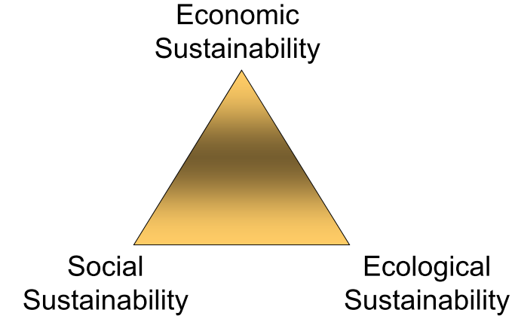
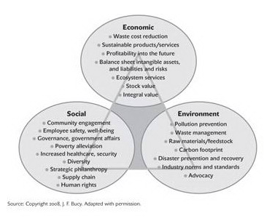
3-D Model of Sustainability
“That which meets the needs of the present without compromising the ability of future generations meet their own needs”
(Brundtland Report 1987)

Slide 9
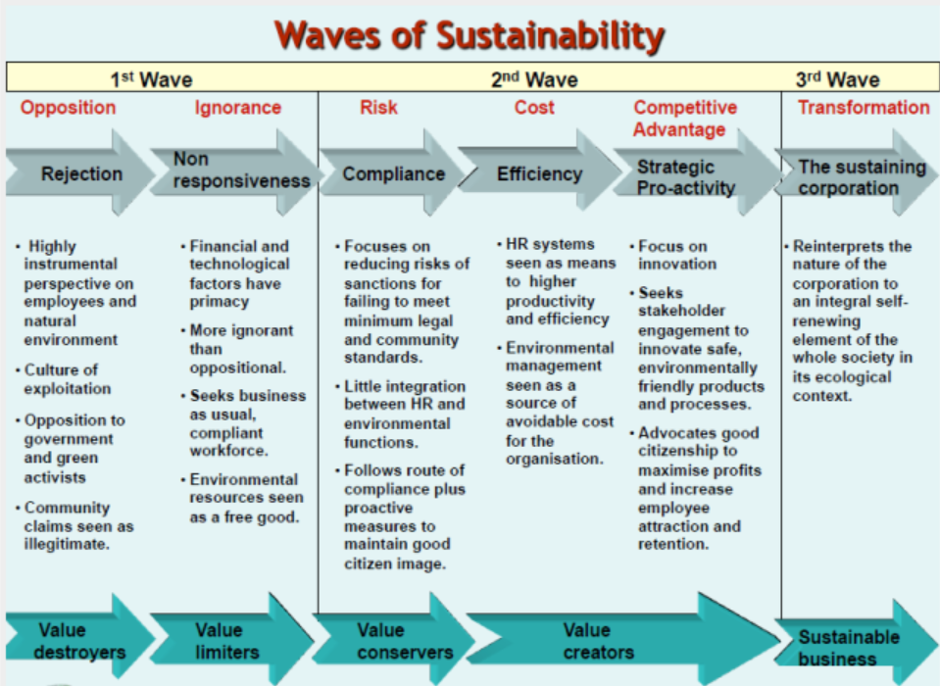
Source: https://7508gbs.wordpress.com/tag/7508gbs/

Slide 10
The concept of sustainable enterprise is related to the general approach to sustainable development, originally enunciated in the Brundtland Report, as “forms of progress that meet the needs of the present without compromising the ability of future generations to meet their needs”. * But!!!
Important!!!
Sustainability is based on biodiversity, the control of environmentally damaging activity and the replenishment of renewable resources – which can protect or even enhance the natural environment. This includes the responsible use of divisible natural resources used directly for production such as trees, water and land. Is it definition for sustainable Company???
* This definition is taken from the World Business Council for Sustainable Development (WBCSD) (http://www.wbcsd.org), which in turn has based its definition on how the Brundtland Commission defined sustainable development. See, Our common future: Report of the World Commission on Environment and Development (the Brundtland Report), 1987. Historians of sustainable development may argue that the concept owes its birth to the 1972 United Nations Conference on the Human Environment in Stockholm which, among other things, led to the creation of UNEP.

Slide 11
Companies not interested in sustainable development issues will not survive long.
- Malcolm Brinded, Chairman of Shell UK, 1999
Myth | Reality
Nobody knows what sustainability really means | Definitions “Sustainable” or “Sustainability” say nothing about protecting the environment
Sustainability is all about the environment | The economy is based on the biosphere. The biosphere provides everything that makes life possible, assimilates our waste or converts it back into something we can use
“Sustainable” is a synonym for “green” | A preference for the natural over the artificial
It’s all about recycling | Recycling is important: reusing metals, paper, wood and plastics rather than tossing them reduces the need to extract raw materials from the ground, forests and fossil-fuel deposits. But the most important areas by far in terms of sustainability are energy and transportation
Sustainability is too expensive | It’s only true in the short term in certain circumstances but certainly not in the long term
Sustainability means lowering our standard of living | Addressing climate change is the biggest job creation program there is Sustainability allow us to be prosperous, fed, clad, secure
Consumer choices, not government intervention, offer the fastest, most efficient routes to sustainability | Assumption that wasteful use of resources and the destruction of the environment is without cost?!? The depletion of natural resources, rising prices will automatically push people into more efficient behavior!?!
New technology is always the answer | Not necessarily. Sometimes existing technology can make a huge difference. Sometimes it takes a creative business model.
Sustainability is ultimately a population problem | This is not a myth. Sustainability is ultimately a population problem.
Once you understand the concept, living sustainably is a breeze to figure out. | You cannot really declare any practice “sustainable” until you have done a complete life-cycle analysis of its environmental costs.

Slide 12
The main focuses
Sustainability does not have to come at a cost. A well-designed sustainability program can help companies increase profits by generating savings, driving growth, and reducing risk.
Creating a sustainable enterprise involves transforming the entire value chain from the supply of materials to product design, operations, sales and marketing, and end-of-life management.
To support the building of sustainable enterprises, it is necessary to identify opportunities to promote growth through new products, new markets, and the composition of the business portfolio; to improve return on capital through green sales and marketing, sustainable value chains, and sustainable operations; and to manage risk, whether regulatory, reputational, or operational.

Slide 13
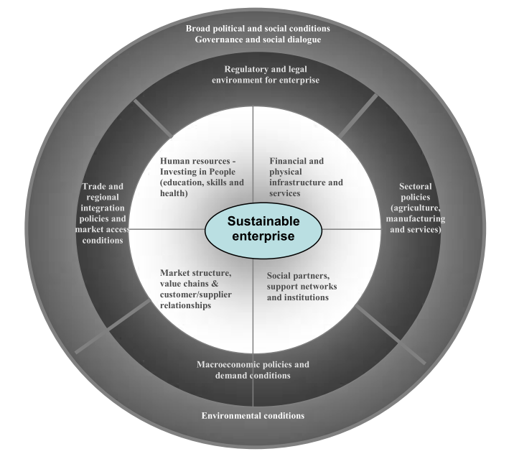
Source: Report VI «The promotion of sustainable enterprises» / International Labour Conference, 96th Session, 2007

Slide 14
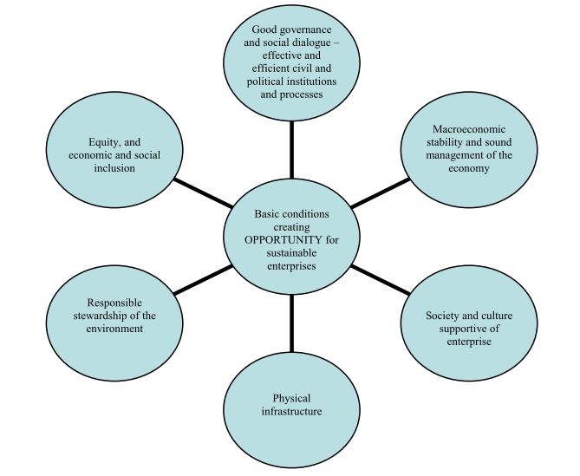
Basic conditions creating the opportunity for sustainable enterprises

Slide 15
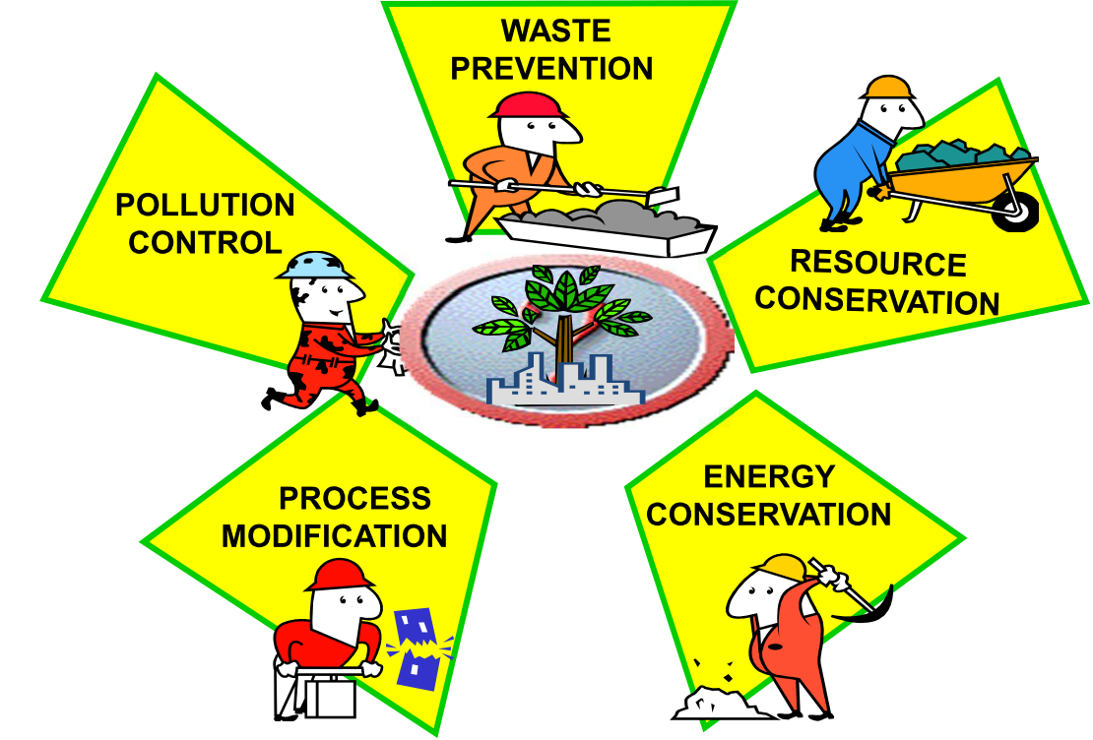
Sources for profitable activity

Slide 16
A sustainable company operates a business so as to be viable, grow and earn a profit.
Sustainable company recognizes the economic and social aspirations of people inside and outside the organization on whom the enterprise depends, as well as the impact on the natural environment.

Slide 17
“Sustainable enterprises should innovate, adopt appropriate environmentally friendly technologies, develop skills and human resources, and enhance productivity to remain competitive in national and international markets’’.
ILO-Labour Conference 2007

Slide 18
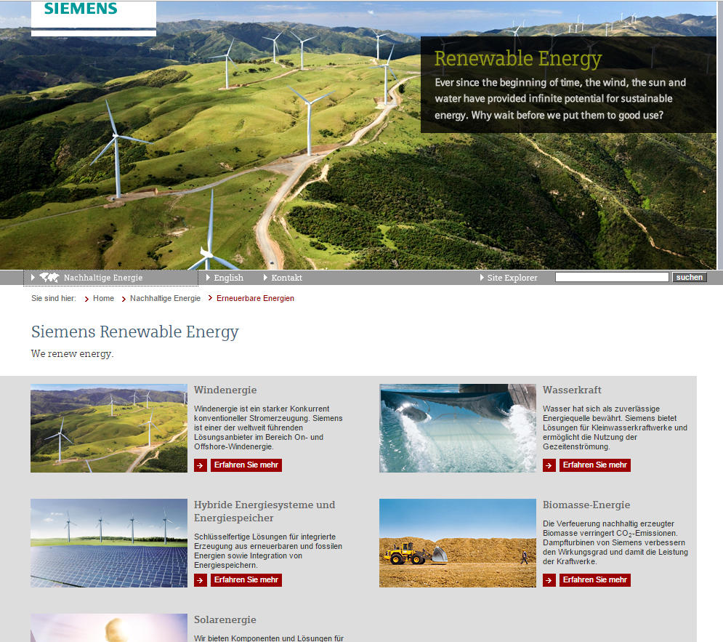

Slide 19
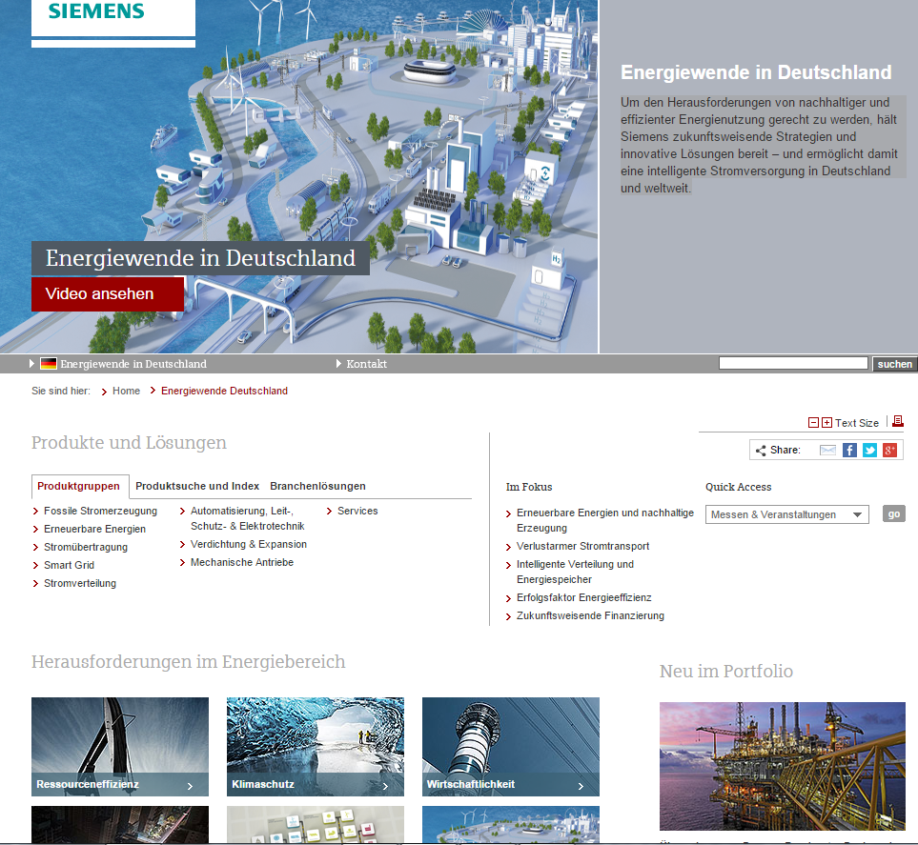

Slide 20
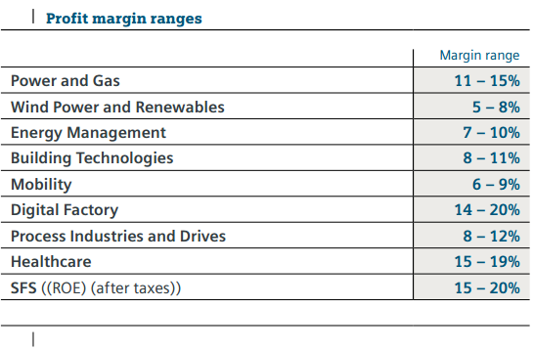
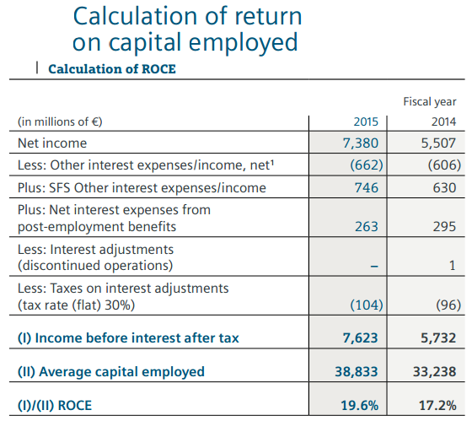
http://www.siemens.com/investor/pool/en/investor_relations/Siemens_AR2015.pdf

Slide 21
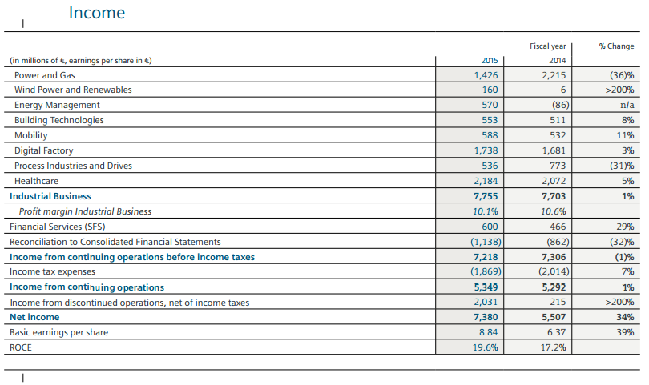
http://www.siemens.com/investor/pool/en/investor_relations/Siemens_AR2015.pdf

Slide 22
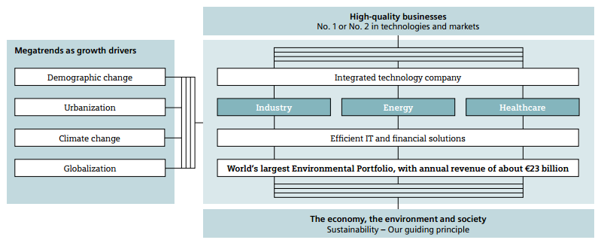
http://www.siemens.com/investor/pool/en/investor_relations/e09_00_gb2009.pdf

