Slide 1
Sustainable enterprise development
Prof. Dr. Olga Popova

Slide 2
¤ It matters little how much information we possess about development if we have not grasped its inner meaning.
—DENIS GOULET, The Cruel Choice
¤ Development must be redefined as an attack on the chief evils of the world today: malnutrition, disease, illiteracy, slums, unemployment and inequality. Measured in terms of aggregate growth rates, development has been a great success. But measured in terms of jobs, justice and the elimination of poverty, it has been a failure or only a partial success.
—PAUL P. STREETEN, Former Director, World Development Institute
¤ Our new framework is a holistic and integrated approach to development strategies and programs that highlights the interdependence of all aspects of development strategy— social, structural, human, institutional, environmental, economic and financial.
—JAMES D. WOLFENSOHN, President, World Bank

Slide 3
Interrelation between Sustainable Development, Economic Growth and Economic Sector
What is “Development” and “Growth” ?
What is the difference between economic growth and development?
What does it mean for a enterprise to be in “developing” or “developed”?
What factors (economic, political, cultural, social etc.) are necessary for development to occur?
The 80/20 rule does apply … (The richest 20% of the world’s population receives more than 80% of the world’s income; at the other end of the spectrum …)
The poorest 60% receives less than 6% of the world’s income
Example: The GDP of the U.S. is about 70% greater than the combined GDPs of all the developing countries in the world; The U.S.(with only 5% of the world’s population) accounts for more than 30% of the world’s output.
Basic recourses Natural resources
Human resources
Capital formation
Technology
Sociocultural and institutional factors
…. What else or it is enough to be in “developing” or “developed”

Slide 4
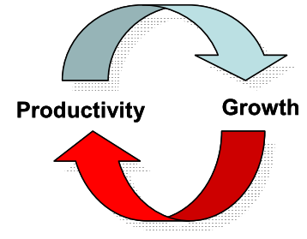
Economic Growth | Development
Economic Growth is a narrower concept than economic development. It is an increase in a enterprise's real level of output which can be caused by an increase in the quality of resources (by education etc.), increase in the quantity of resources & improvements in technology or in another way an increase in the value of goods and services produced by every sector of SBA. Economic Growth can be measured by an increase in a enterprise's GDP(gross domestic product). | Economic development is a normative concept i.e. it applies in the context of people's sense of morality (right and wrong, good and bad). The definition of economic development given by Michael Todaro is an increase in living standards, improvement in self- esteem needs and freedom from oppression as well as a greater choice.
Churchill and Lewis’s (1983) model breaks the growth continuum into six stages of development: existence, survival, success–disengage, success–growth, takeoff, and resource maturity. At each stage of a firm’s growth, different critical factors tend to become important, such as owner objectives, managerial skills, access to capital, technology, and human resources.

Slide 5
 | Economic Development | Economic Growth
Implications | Economic development implies changes in income, savings and investment along with progressive changes in socio-economic structure of enterprise (institutional and technological changes). | Economic growth refers to an increase in the real output of goods and services in the enterprise.
Factors | Development relates to growth of human capital indexes, a decrease in inequality figures, and structural changes that improve the general population's quality of life. | Growth relates to a gradual increase in one of the components of Gross Domestic Product: consumption, government spending, investment, net exports.
Measurement | Qualitative. | Quantitative.
Effect | Brings qualitative and quantitative changes in the economy of enterprise | Brings quantitative changes in the economy of enterprise
Relevance | Economic development is more relevant to measure progress and quality of life in developing nations. | Economic growth is a more relevant metric for progress in developed countries. But it's widely used in all countries because growth is a necessary condition for development.
Scope | Concerned with structural changes in the economy | Growth is concerned with increase in the economy's output

Slide 6
Sustainable development is about more than just environmental issues. It requires the integration of all three pillars of development: economic growth, social progress and environmental issues. The social dimension of sustainable development typically includes “a commitment to promote social integration by fostering societies that are stable, safe and just and which are based on the promotion and protection of all human rights and on non-discrimination, tolerance, respect for diversity, equality of opportunity, security and participation of all people including the disadvantaged and vulnerable groups and persons”.
A central tenet of the social pillar of sustainable development is, of course, the generation of secure livelihoods through freely chosen productive employment.
Sustainable development, therefore, is a framework for the general global dialogue on growth and development but also for the more specific discussion on enterprise development and, within that, it provides a sound basis to frame the debate on regulation and voluntary action in the sphere of business.
    The main question: Is it suitable for characteristic “sustainable development of company”?

Slide 7
Table 1 The SWOT analyze of sustainability for company
Internal factors | External factors
Strengths • Own proprietary technologies • Company’s tradition • Corporate values • Recognized specialists among company’s employees • Recognized trademarked products and services • Good reputation among customers • Low costs • Available production capacities for products demanded on markets • Access to high quality resources • Good distribution networks | Opportunities • Increased demand for company’s products • New technologies • Extension to other domains • Possibility to buy or merge with other companies (diversification of products portfolio) • Permissive legislation • New markets • Removal of custom or / and commercial barriers
Weaknesses • Management issues, Lack of interest from personnel, weak communication between departments • Slow adaptability to market requirements, low performance technologies • Lack of trademarked products • Bad reputation among clients, lack of distribution networks • Non-used capacities, high consumptions • High costs for products with low added value • Lack of access to resources | Threats • Company’s products are not fulfilling the standards • Appearance of more efficient competitors • Restrictive legislation • Political / economic situation • New custom or / and commercial barriers • Unfair competition

Slide 8
What are the opportunities for business enterprise in the context of sustainable development? At the international level, globalization and trade liberalization offer enterprises the possibility to expand their activities, boost their competitiveness level, use the best technology to reduce their costs at least in the long term. The realization of these benefits/opportunities depends on the size of the enterprise, how the enterprise deals with challenges, and its resilience. At the local level, opportunities are generally size and/or sector specifics. As a general rule, the bigger the enterprise the more opportunities in hand. This is a serious incentive for the small enterprises to be part of the supply chain of large corporations. Note that SMEs being labour-intensive are beneficial to low-skilled workers; they provide the latter with more opportunities to work. In other words, SMEs have an important role to play in the solution of income distribution and inequality.
There are benefits for business enterprises to behave environmentally friendly. Indeed, the greening of their activities might provide them with benefits which in the long run outweigh costs. More importantly, the beneficial effects of greening may often go beyond the realm of a given business as they may touch the nation as a whole including its social and economic fabric.

Slide 9
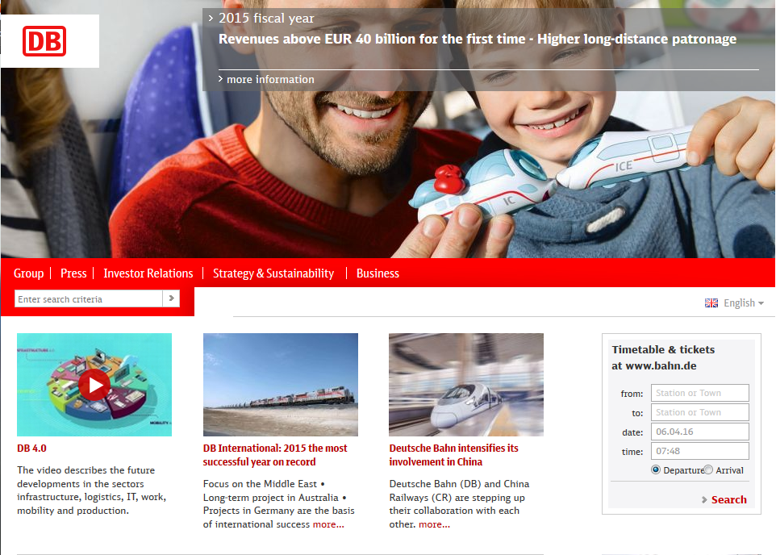

Slide 10


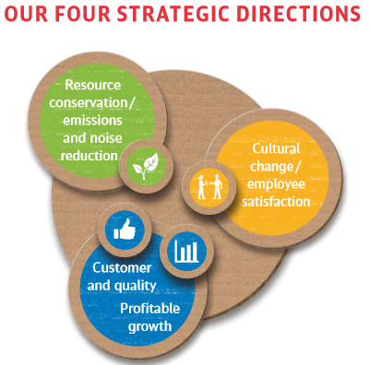
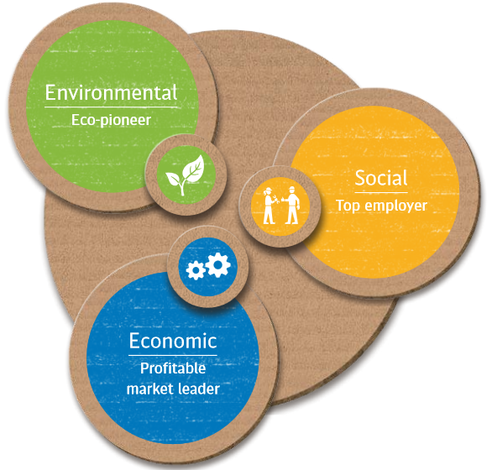
http://www.deutschebahn.com/file/en/2211562/Q8XvkT2Q0BRnHoyOyafwwY8TRVw/9252498/data/ib2014_dbkonzern_en.pdf

Slide 11
In order to develop environmental protection into an integral component of our business activity, we rely above all on the enthusiasm, motivation and knowledge of our employees. They can make an essential contribution in their daily practice with environmentally sound and forward-looking action to further expand our lead in environmental issues. We have developed special training programs on environmental protection that are implemented by DB Training in collaboration with DB Environment. In the year under review, we trained about 800 employees in the context of 70 environmental courses. Our aim is to inspire all DB employees to intensify their commitment to the environment and to constantly keep their knowledge up to the latest standards.

Slide 12
In many cases, replacing business travel with conference calls saves time and money while protecting the environment. In the year under review, about 200,000 conference calls took place with more than 900,000 participants. This is an increase of 20% over 2013.
In 96% of the cases, participants came from different cities or called in while underway. At least one participant is thereby spared the need to travel, which saves energy. The number of video conferences (65,000) has more than doubled. In addition, executives receive both nvironmentally friendly company cars and a network ticket, which contributes to reducing CO₂ emissions

Slide 13
For DB Schenker Logistics (land, air, ocean), emissions are calculated on the basis of individual dispatch data. The EcoTrans IT World tool provides support in determining distances. Total transport volumes per means of transport are derived from the distances and transport volumes, and then are combined with emissions factors related to trade lane, distance class or performance class. External studies on efficiency developments are also considered, such as those from the International Air Transport Association (IATA; air) and Clean Cargo Working Group (ocean). In bus service, emissions are calculated from the consumption of fuel-dependent CO₂ factors.

Slide 14
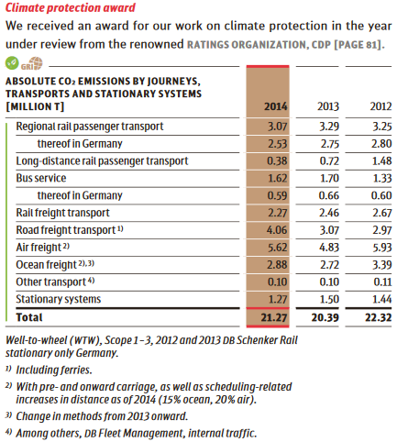

Slide 15
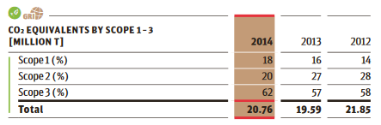
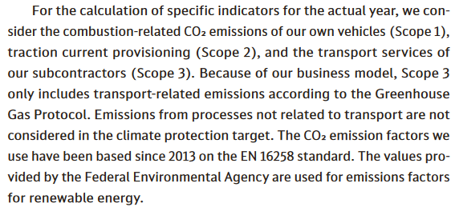

Slide 16
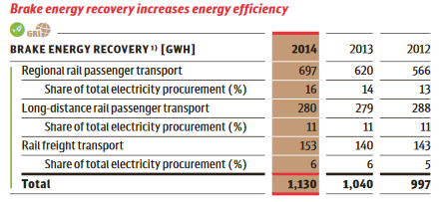
Modern rail vehicles, such as the 442 series in regional transport, are able to convert part of their kinetic energy into electrical energy upon braking and to feed it back into the traction current grid. In the northeast region, DB Bahn Regional has over 80 vehicles of this type in service; the average brake energy recovery in the year under review was over 30%. At DB Bahn Long-Distance, the first new ICE 3 train of the 407 series went into passenger
service in the year under review; it fed back in about 24% of the recovered energy. That is 15% more than for comparable older vehicles of the 403 series. The volume of recycled electricity increased in the year under review, with savings of about 14% in total electricity procurement.
Gigawattstunde [GWh]

Slide 17
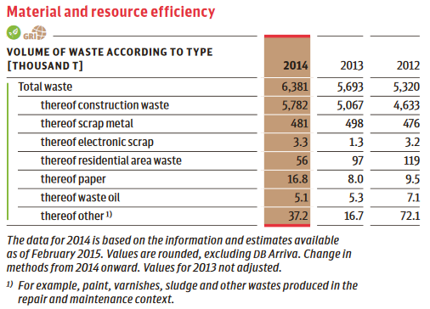

Slide 18
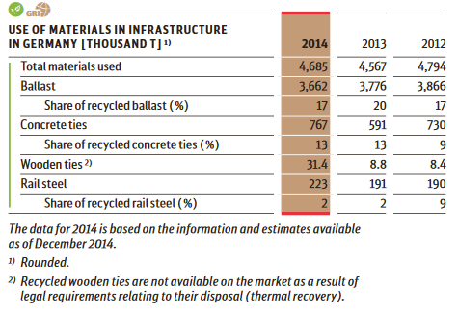

Slide 19
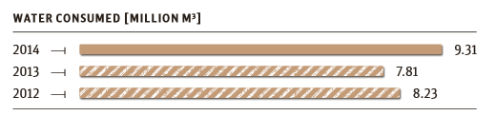
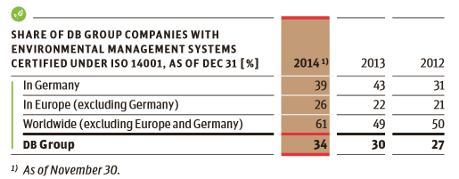

Slide 20
Company’s Board of Managing Directors is responsible for the proper preparation of the information in the section “Additional information on sustainability” of the “Integrated Report 2014” of the Company in accordance with the criteria stated in the Sustainability Reporting Guidelines of the Global Reporting Initiative (GRI):
Materiality,
Stakeholder Inclusiveness,
Sustainability Context,
Completeness,
Balance,
Clarity,
Accuracy,
Timeliness,
Comparability and
Reliability.

