Slide 1
Natural Resources and their Potential for Sustainable Enterprise Development
Prof. Dr. Olga Popova

Slide 2
As businesses are formulating their sustainability strategies they are asking the following questions:
How green and sustainable can a given business operation or process be? What opportunities exist for efficiency improvements or risk elimination so that the business process is green and sustainable?
What environmental regulations must an enterprise comply with? Are there any incentives, financial or otherwise, available for compliance?
How green can a building or a facility be? What incentives might be available if a building or facility becomes more green and sustainable?
Are our procurement and supply chain processes sustainable and profitable?
How much data or information may be redundant? Will elimination of redundant data reduce storage requirements and provide better efficiency of a data center?
What standards exist — or might be in development — that allow an organization to measure, monitor, and report on its levels of green and sustainability?
How can we get investment? The bottom line is: “Can we cash in on some aspects of our greenness and sustainability?”

Slide 3
In the overall context of the state of the resource potential of the company is reflected in the availability of resources, defining opportunities for economic development of the enterprise. The composition of the resource potential of the enterprise includes items such as personnel, finance, fixed and circulating capital, organizational and managerial capacities, potential customer relationships, building and transport potential.
Modern researchers, considering the nature of the resource potential tend to put emphasis on its components and their stability.

Slide 4
it is necessary to divide the factors for sustainable economic development of enterprises in two groups. The first group of factors related to the mobilization of existing reserves are operational in nature and DO NOT REQUIRE A SIGNIFICANT INVESTMENT. The second group of factors related to the reform of various spheres of activity of the enterprise, based on the use of INNOVATION AND IMPROVING THE QUALITY OF HUMAN RESOURCES. Such factors are of strategic importance for the management of the economic sustainability of the enterprise.

Slide 5
Ability to control the economic sustainability of enterprises is determined by human and institutional capacity in the presence of a number of additional assumptions:
THE ABILITY OF BUSINESSES TO GENERATE REVENUE;
THE EXISTENCE OF NEW SOURCES OF FUNDING;
PRESENCE OF A STRONG MANAGEMENT TEAM.
However, to ensure sustainable economic development of enterprises should balance the elements of resource potential. In the structure of the resource potential (Table below) we isolated: production, personnel, financial, market potential and the potential of the organization and innovation. For each type of building are presented pivotal and peripheral elements.

Slide 6
Natural Resources are all that exists without the actions of humankind.
Natural resource is something that is found in nature and can be used by people.
Natural resources are natural assets (raw materials) occurring in nature that can be used for economic production or consumption.
Natural environment means all living and non-living things that are naturally on Earth.

Slide 7
In terms of the source of origin, natural resources can be divided into the following types:
Biotic: these resources come from living and organic material, such as forests and animals, and include the materials that can be obtained them. Biotic natural resources also include fossil fuels such as coal and petroleum which are formed from organic matter that has decayed.
Abiotic: these resources come from non-living and non-organic material. Examples of these resources include land, fresh water, air, and heavy metals (gold, iron, copper, silver, etc.).

Slide 8
Natural resources can also be categorized based on their stage of development including:
Potential resources: these are resources that exist in a region and may be used in the future. For example, if a country has petroleum in sedimentary rocks, it is a potential resource until it is actually drilled out of the rock and put to use.
Actual resources: these are resources that have been surveyed, their quantity and quality has been determined, and they are currently being used. The development of actual resources is dependent on technology.
Reserve resources: this is the part of an actual resource that can be developed profitably in the future.
Stock resources: these are resources that have been surveyed, but cannot be used due a lack of technology. An example of a stock resource is hydrogen.

Slide 9
Natural resources are also classified based on their renewability:
Renewable natural resources: these are resources that can be replenished. Examples of renewable resources include sunlight, air, and wind . They are available continuously and their quantity is not noticeably affected by human consumption. However, renewable resources do not have a rapid recovery rate and are susceptible to depletion if they are overused.
Non-renewable natural resources: these resources form extremely slow and do not naturally form in the environment. A resource is considered to be non-renewable when their rate of consumption exceeds the rate of recovery. Examples of non-renewable natural resources are minerals and fossil fuels.

Slide 10
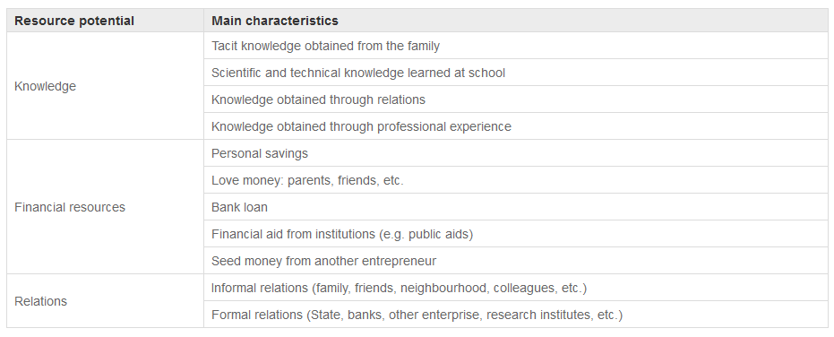

Slide 11
Typology of the resource potential in sustainable enterprise development
 | Production potential | Personnel potential | Financial potential | Market potential | Capacity of the organization and innovation
1. Content of possibilities | Reflects the possibility of using industrial base to allow for production | Reflects the possibility of using the knowledge, skills, talent staff, combined with production capabilities | Reflects the ability to attract resources of a certain composition, cost and quality, the effectiveness of their use. | Reflects aggregate capacity of demand and supply for efficient activity in the market | Reflects the ability to use the organizational structure and culture to achieve
2. Stem elements | Technology, patents and licenses, work experience and its carriers | Management team, competence, knowledge, personnel, etc. | Relationship with banks and tax authorities, credit rating | Relationship with customers, the attractiveness of products, market information | Organizational core (mission and culture)
3. Peripheral elements | Property complex production infrastructure, the prospects for output | Powers and responsibilities of employees, personnel structure, the wage fund | Receivables and payables, cash turnover, reserves of finance | Market positions and segments, brand, sales promotion | Organizational structure
4. Contents of monitoring | Assessment of production capacity, equipment depreciation, load; ways to modify | Assessing the level of training, the level of production discipline, performance analysis responsibilities | Impact assessment, the current solvency and fin. stability, dynamics of the fin. reports | Positional analysis, market segments, competition analysis, assessment of demand factors | Analysis of mission and objectives, strategies, org. structure, analysis of org. culture.

Slide 12
The problems of the assessment of the enterprise potential , possible variants of the sustainable enterprise development according to the level of the potential use based on the available resources (especially natural) are reported in a number of papers by domestic economists. Among the suggested methods of the assessment, the methods of the evaluation of the enterprise potential become a frequent practice, including matrix methods, indicator methods, logistic methods, the integral criterion method, the Gradov method, the comparison method, the Porter theory of competitive advantages, the Ansoff method, the method of profile definition etc.

Slide 13
A substantial attention of the researchers is attracted by the use of peer assessment when measuring the potential. In particular, the use of the graphical and analytical method of the square potential is recommended, being based on the peer review of the potential of the sustainable enterprise development. Account of special factors of the resource flow in the course of formation of the sustainable enterprise development potential becomes possible when logistic methods are applied especially algorithmic ones. The methods are based on the assumptions as follows: STEP analysis; SPACE analysis; GAP analysis; LOTS analysis; PIMS analysis.
The scientific and methodical tools of the assessment of the resource potential of the sustainable enterprise development have been insufficiently devised, so the reserve of the enhancement of the efficiency of the business activity can be revealed in practice.

Slide 14
Formulation of the method of assessment of the resource potential of the sustainable enterprise development should be based on the definition of the specific features, the structure and fixed principles that could allow the assessment procedure to become an universal method of the enterprise management. The main specific feature of the assessment of the resource potential of sustainable enterprise development is provided integral presentation of the cause-and effect links between the level of the resource use. Their potential is a tool of the resource transformation into the economic goods aimed at satisfaction of needs and possibility of further development upon condition of the consumption of the goods, that can be found as new achieved financial and economic sates of the enterprise. Thus, the defined specific features of the assessment procedure allow formulation of a set of the assessment principles. First of all, any resource can be characterized with respect to the potential value. This fact means that the resources acquire the status of the resources themselves when they are directly used in the course of the business activity of the enterprise. So, the resources should be treated as conditions of the formation of the enterprise potential. The content of the next principle of the assessment is that the enterprise can affect the level of the intensity and the volume of the resources consumption by the selection of the combination of the mission-essential resources and the providers of the resources. The consequences of the choice determine the direction of the enterprise development, because the financial and economical results can be both positive and negative.

Slide 15
With proper account of the established principles, the procedure of the assessment of the resource potential of the sustainable enterprise development can be recommended, that can be presented as a set of stages realized step-by-step.
Stage 1. Description of the current situation.
Stage 2. Development and analysis of the evolution scenarios.
Stage 3. Assessment of the scenario effect on the financial and economical state of the enterprise.
Stage 4. Characteristics of the conformance of the development with economic, social and ecological criteria.
Stage 5. Modeling of the assessment of the resource potential of the sustainable enterprise development .
According to the suggested stages, scientific and methodical approach to the estimation of the resource potential of the sustainable enterprise development should include the following operations.

Slide 16
The resource potential of an sustainable enterprise development is formed to a great extent under the effect of the available resources in the environment and the reserves of the inner resources at disposal of the enterprise. Thus, the functional relation of the resource potential and the aggregate of the resources involved to the business activity in some form can be presented as follows:
RP=f(R_{res})=f(R_{avail}+R_{inner}) (1)
where RP is the resource potential of the sustainable enterprise development , EUR; R_{res} is the reserve of the resources, EUR; R_{avail}, R_{inner}. are available and inner resources of the sustainable enterprise development , respectively, EUR.

Slide 17
Resources are defined broadly to be natural or anthropogenic stocks that are required for the creation, use and disposition of a product or service.
Provisioning services (production of food and water etc);
•
Regulating services (e.g. the control of climate and disease);
•
Supporting services (e.g. nutrient cycling and crop pollination); and
•
Cultural services (such as recreational/tourism benefits).
R_{res}= f(P,І,Т,Q) (2)
where P is the price of the resource, EUR/unit;
І is the volume of the investments, EUR;
Т is the applied technology, EUR;
Q is the product, EUR.

Slide 18
A question arises, what are possible concrete manifestations of the functional relation of the sustainable enterprise development and the level of use of the resource potential of the enterprise. The most rational use can be associated with two functions that are an exponent and a logarithm. Useful application of an exponent is determined by the fact that the development of the enterprise can be accelerated when the volume of the resources increases. A special case is the utilization of limited resources with ongoing price of the use. This situation takes place when limited natural resources are utilized, especially fuel and energy ones. This type of resources is characterized by production and sales volume gain at ever-increasing prices. This fact allows economic agents dealing with this kind of business transactions to get excess profits. At certain conditions, extensive orientation to the provided sustainable enterprise development of the economic agents can provoke growth retardation: being accompanied by growing volume of the resources used, the increase in price can determine the costs structure untenable from the viewpoint of the social value of the production. As a result, a negative attitude toward the product will be formed in the market and the development rate will be reduced. In the limiting cases, the production will be stopped. The mentioned specific features allow making a statement about appropiate use of a logarithm, when describing the situation.

Slide 19
The assesssment of the sustainable enterprise development potential can be made by evaluation of the rate of the function response to the argument variation in the form:
RPD=RP'=f'(R_{res}) (3)
where RPD is the dimensionless assessment of the resource potential of the sustainable enterprise development;
RP' is the first derivative of the resource potential function that represents the rate of the changes of the financial and economic standing of the sustainable enterprise development.
The revealed dependence is illustrated in Fig.1.

Slide 20
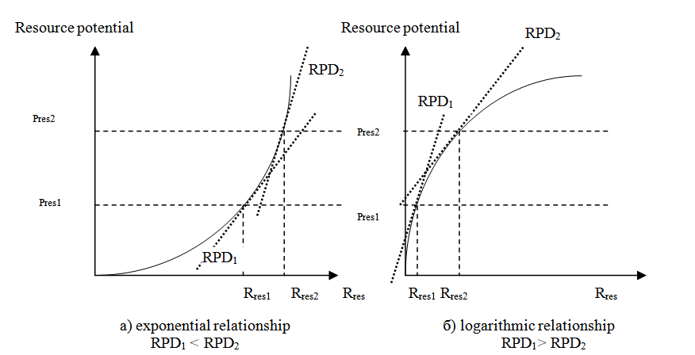
Fig. 1 Variants of the formation of the assessment of the resource potential of the sustainable enterprise development

Slide 21
Graphical presentation of the procedure of assessment of the resource potential of the enterprise development allows establishing of an explicit quantitative relation between the volume of the resources attracted and the resource potential of development. The last parameter is recommended to be measured according to the cost characteristic of the resources introduced into commerce and the assessment of the resource potential of development. Application of the reported scientific and methodical approach to the assessment of the resource potential of the enterprise development is of practical value when taking business decisions concerning the choice of the volume and the cost of the resources attracted.

Slide 22
Conclusions.
The performed analysis allows making the following conclusions.
1. The levels of intensity and efficiency of the resource utilization at domestic enterprises are of unstable dynamics determined by insufficient clarity of recommendations for estimation of the direction of the development at varied level of the use of resource potential of an enterprise.
2. In the present paper, a number of principles of the assessment of the resource potential of the enterprise development have been suggested. The stages of the assessment procedure have been formulated where the resources have to be treated as conditions forming the enterprise potential and opportunities of the enterprise to affect the intensity level and the volume of the resource utilization.
3. The assessment of the enterprise development is recommended to be made with using the first derivative of the enterprise potential. The form of the derivative is determined by the financial and economic results of activity, to be presented quantitatively as a logairthm or an exponent.
4. Further application of the suggested scientific and methodical approach will demand formulation of a system of criteria for the assessment of sufficiency and balance of development. The system will form a basis for revealing and utilization of the reserves to enhance the efficiency of business activity.

Slide 23
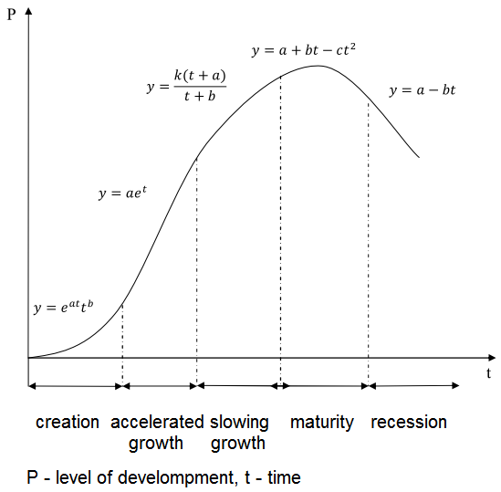
Development trajectory

Slide 24
A strategy for sustainable development cannot be limited only to economic, technological actions directly linked to the human activity. It has to include, as the above mentioned definitions stated, both environmental and social factors, the present and the horizon for the next generations.
The principles on which the model for strategic development and enterprises is based and also constitute the main strategic directions for sustainable development are listed below:
1. Stability and viability of both human and natural systems
2. Ecological sustainability
3. Economic sustainability
4. Social sustainability
5. Cultural and educational sustainability
6. Global sustainability

Slide 25
Although environmentalists have called for companies to increase business sustainability for many years, there are now a number of pressing reasons for companies to increase sustainability in addition to environmental factors. The increase in fuel and energy costs as well as growing manufacturing and production costs means that companies are now looking for alternative operating methods which can enable them to operate effectively but also reduce running costs. In addition to this, regulations specifically aimed at limiting damage to the environment have forced companies to consider their impact on the environment. As public awareness regarding sustainability has grown, companies have faced increasing pressure to adopt sustainable policies. These factors have led to a rise in the number of firms adopting policies and attempts have been made by numerous companies to increase business sustainability.
As awareness of sustainability grows, pressure on companies will continue to increase. In addition to pressure from the public, companies face pressure from the government and the introduction of new legislation aimed at increasing sustainability. The opportunity to reduce costs, increase profitability as well as limiting damage to the environment means that companies are responding to the need for change and are continuing to adopt new sustainable strategies designed to increase business sustainability in the long term.

Slide 26
Contemporary business environment is related to attraction of a wide spectrum of resources aimed at satisfaction of steadily increasing social needs. The level of the efficiency of the resource use and the time-dependent intensity of consumption determine the production output, form the competition positions of the enterprise and control the direction and the rate of development in the future to a considerable extent. The interrelation of the current state of the business activity and the future one requires certain measures aimed at assessment of the abilities of the enterprise development with respect to the use of the resource base of the production, modeling of possible state of the enterprise depending on the achieved and possible rates of the resource use.
The revealed insufficient efficiency of the resource use in the course of the business activity is determined by a number of factors including dominating absence of the consistent approach to the assessment of the prospects for further development of an enterprise under different levels of the use of the resource potential.

Slide 27
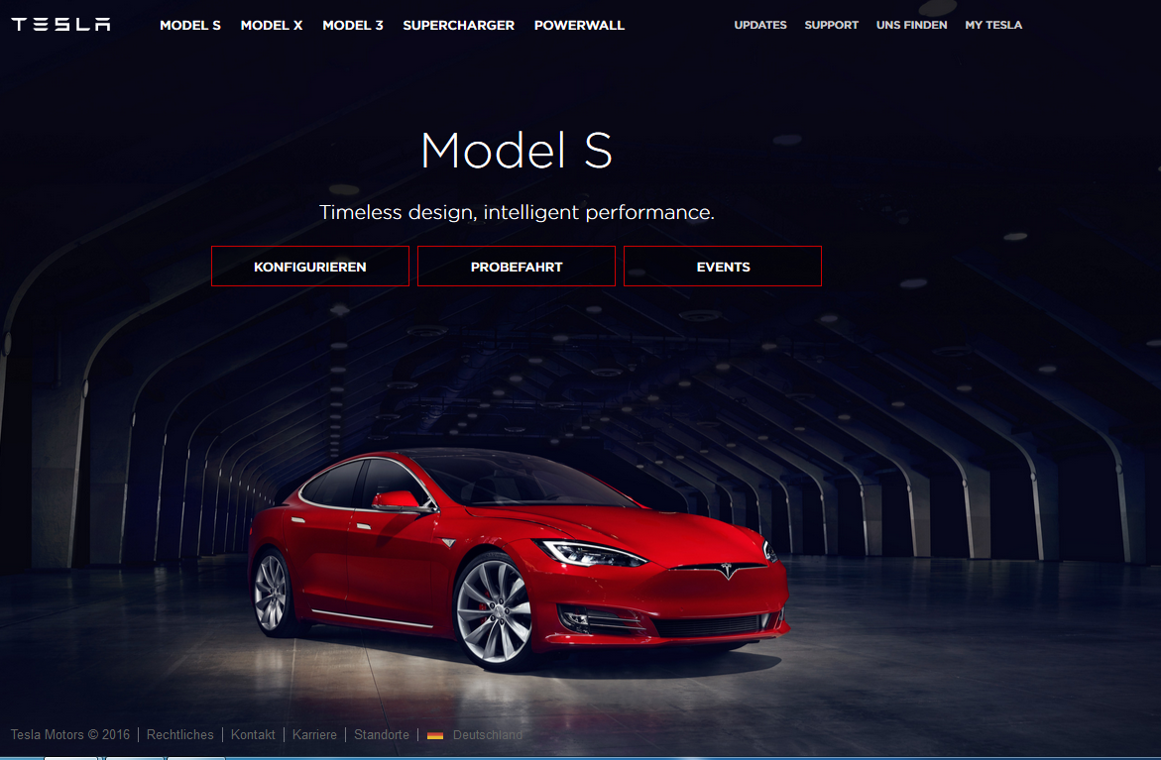
https://www.teslamotors.com

Slide 28
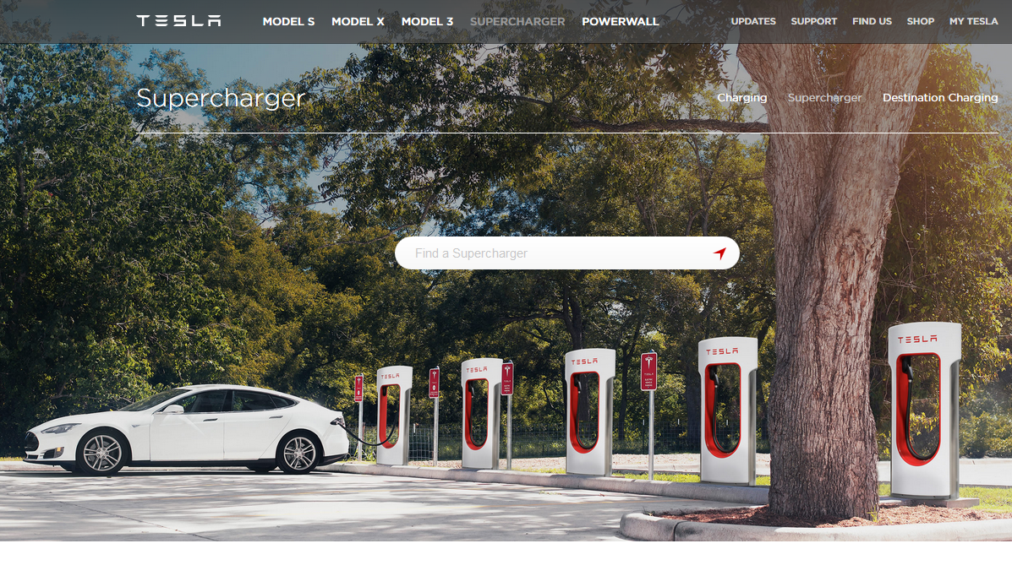
https://www.teslamotors.com

Slide 29
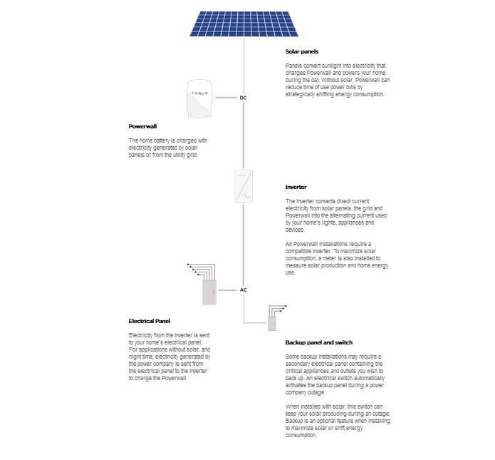
https://www.teslamotors.com

Slide 30
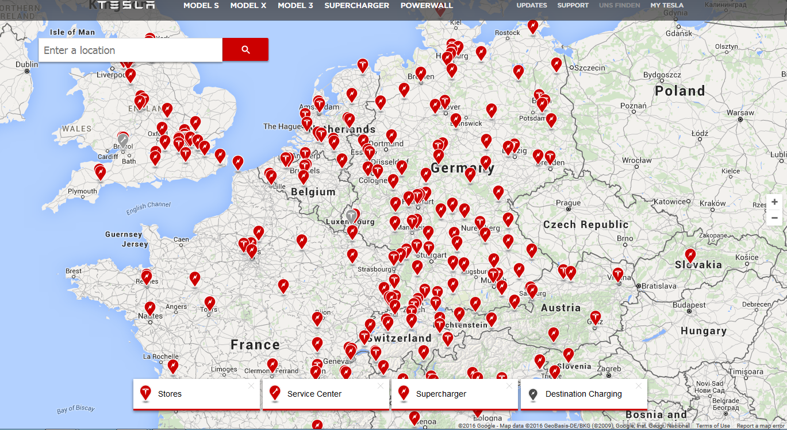
https://www.teslamotors.com

Slide 31

https://www.teslamotors.com

Slide 32
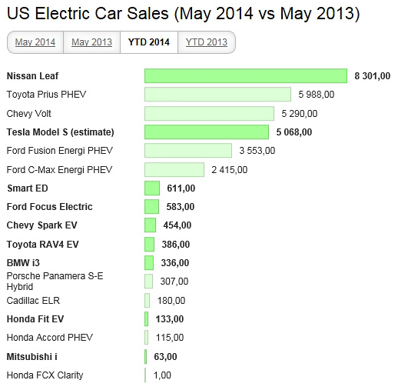
http://www.mobile-review.com/articles/2014/electric-cars.shtml

