Slide 1
Valuating the Sustainable Enterprise Development: principles, models, approaches
Prof. Dr. Olga Popova

Slide 2
A sustainable organization should strive to minimize resource consumption while maximizing value creation. Here, resources are defined broadly to be natural or anthropogenic stocks that are required for the creation, use and disposition of a product or service. Examples of resources include materials, energy, labor, and land. Value is defined as a condition, attributable to a company’s activities, which benefits one or more of the organization’s stakeholders (Fiksel et al, 1998). Examples of value creation include increased profitability, reduced pollution, improved nutrition, and liberation of time.

Slide 3
Principles of sustainability measurement
The first principle of sustainability measurement is | that evaluations should address the dual perspectives of resource consumption and value creation
The second principle of sustainability measurement is | that evaluations should include economic, environmental, and societal aspects.
The third principle of sustainability measurement is | that evaluations should systematically consider each stage in the product life cycle
The fourth principle of sustainability measurement | is that evaluations should combine both leading and lagging indicators of performance

Slide 4
The first principle of sustainability measurement is that evaluations should address the dual perspectives of resource consumption and value creation
Recourses | Values
Costs | Income (Profit)
DIRECT: Natural: Water Land etc. Anthropogenic: Energy Material Human capital Investment capital INDIRECT: Anthropogenic: Wastes (suitable for production) Wastes (requiring recycling) Wastes (nonsuitable for production – pollution) | DIRECT: Economic value added Business competency Brand (Trade Mark) Customer satisfaction INDIRECT: Human health Social welfare Environmental quality Technological progress Information content about causes and effects of pollution

Slide 5



The second principle of sustainability measurement is that evaluations should include economic, environmental, and societal aspects
х – social aspect (damages paid by the consumer)
EP – ecological payment
PC – total productions costs
y – economic aspect (damages paid by the enterprise)
FED - fines for environmental damage
FR – financial results of enterprise activity
z – environmental (sustainable aspect)
TEC – total environmental cost of enterprise
TI – total income
i – time-period or number of enterprise

Slide 6
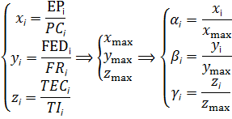
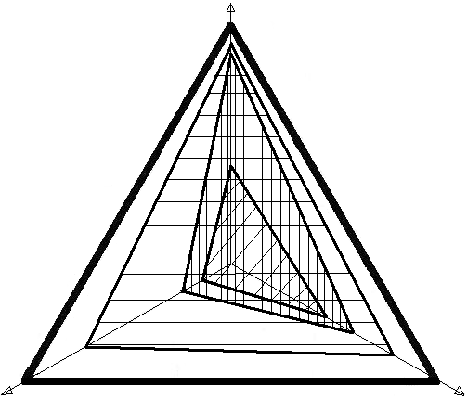
α
Indicators | Dates for enterprises
 | #1 | #2 | #3
α_{i} | 0,86 | 0,99 | 0,65
β_{i} | 0,37 | 0,73 | 0,16
γ_{i} | 0,63 | 0,88 | 0,50
Fill type
β
γ

Slide 7

Valuating the sustainable enterprise development
α
ai
ci
β
bi
γ
Parameters | Enterprises
 | #1 | #2 | #3
a_{i} | 0,86 | 0,99 | 0,65
b_{i} | 0,37 | 0,73 | 0,16
c_{i} | 0,63 | 0,88 | 0,50
pi | 1.365 | 1.85 | 1.01
Si →min | 0.33 | 0.65 | 0.18

Slide 8
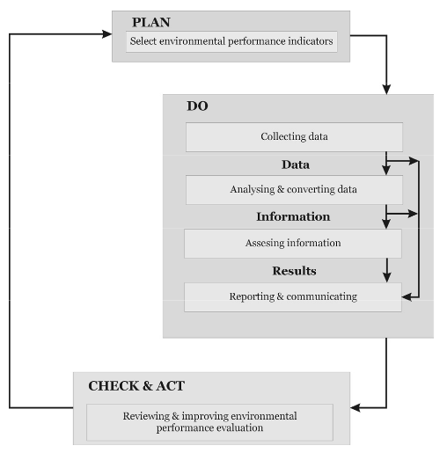
The third principle of sustainability measurement is that evaluations should systematically consider each stage in the product life cycle
Schema of enterprise environmental performance evaluation process
[by: PN-EN ISO 14031:2002 Environmental management - environmental performance evaluation – Guidelines]

Slide 9
Methodology
Interviews with relevant personnel of enterprise (for example 10 individuals including employees and external contractors at the corporate level);
2. Review of internal and external documentary evidence produced by enterprise;
3. Audit of environmental performance data presented in the Report, including a detailed review of a sample of data against source data;
4. Review of enterprise’s information systems for collection, aggregation, analysis and internal verification and review of environmental data

Slide 10
Check and Act
BP2
Прогнозований стан суб’єкта господарювання при забезпеченні екологічної спрямованості розвитку
Фактичний стан суб’єкта господарювання
high
Відступ
backtrack
BP7
Market share
before acts
Ecolocical costs
resource
conservation
Ресурсозбереження
Innovations
BP1
BP3
Інновації
Forecasted market
share
after acts
low
Imitation, reiteration
Standarts
Стандартизація
BP5
BP6
BP4
entering a new market
Вихід на новий ринок
low
high
Total income

Slide 11
The fourth principle of sustainability measurement is that evaluations should combine both leading and lagging indicators of performance
Economic performance indicators Customers (size of market) Suppliers (number of contracts paid in accordance with agreed terms, including penalty arrangements for pollution) Employees (total payroll and benefits (including payments for polluted environmental of workplaces, for human resource sustainable development) Public sector (environmental taxation) | Environmental performance indicators Natural resources conservation and protection Recycling programmes “Green” energy production Waste management Sewage treatment
Social performance indicators Support of human rights in safe consumption Reducing of bribery and corruption Developing of sustainable needs | Sustainable performance indicators Tax credits for green energy consumption Eco-labelling “Green” skills development Eco-innovation “Green” investments

Slide 12
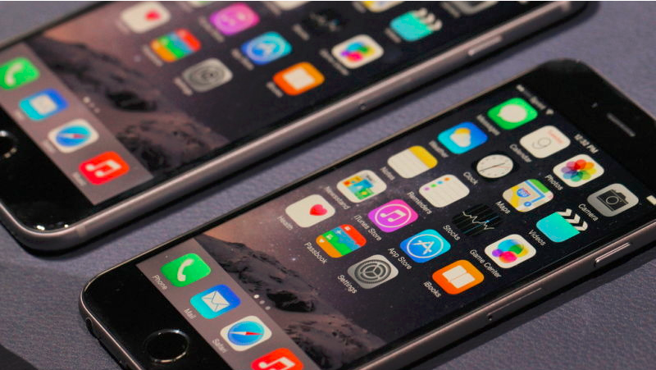

Slide 13
Over the last year, Apple processed 90 million pounds of electronics that were unwanted or broken. It turns out they were nearly worth their weight in gold—a substance which is used heavily in electronics for its conductivity and resistance to corrosion.
As stated in Apple’s environmental report, about two thirds of that 90 million pound scrapheap was composed of reusable materials, with steel, cobalt, aluminum, copper, and silver among them. 2,204 pounds of the spent or abandoned Macs and iDevices were gold, which is approximately $40 million worth of the stuff.
http://gizmodo.com/apples-recycling-program-netted-40-million-in-gold-las-1771413227

Slide 14
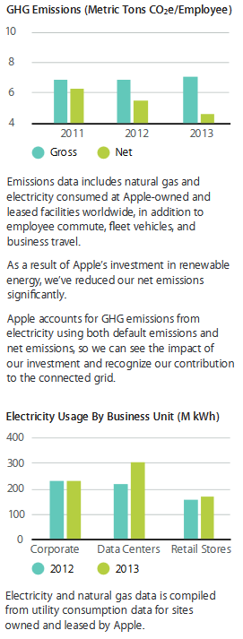
How our carbon footprint informs our thinking
We’re always trying to improve the way we conduct our greenhouse gas life cycle analysis. And when our assessments reveal a material, process, or system that’s making a significant negative impact on our carbon footprint, we reexamine how we design that product, process, or facility. For example, we were using industry-standard methods to account for our emissions from aluminum, but because we use aluminum in so many of our products, we decided to undertake an extensive survey of our aluminum suppliers.
Our study revealed that emissions associated with manufacturing our aluminum housings were nearly four times higher than we believed, so we’ve updated our 2013 life cycle analysis data to be more accurate. As a result, the carbon emissions we reported for 2013 are 9 percent higher than the carbon emissions we reported for 2012. However, this increase is due to previously underestimating our emissions, not because our emissions increased.
In fact, when we recalculated the 2012 data using the new methodology, our carbon emissions actually dropped by 3 percent year over year. We’re committed to continuing to reduce our greenhouse gas emissions and using our life cycle analysis to drive that change.

Slide 15
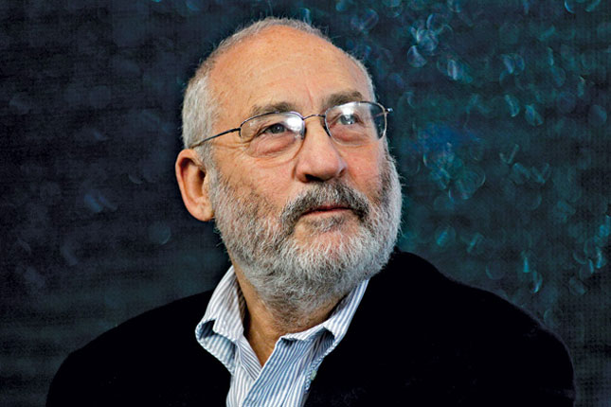
Joseph E. Stiglitz
University Professor, Columbia University
University Professor. Teaching at the Columbia Business School, the Graduate School of Arts and Sciences (Department of Economics) and the School of International and Public Affairs
Co-founder and Co-President of the Initiative for Policy Dialogue (IPD)
Co-Chair of the High-Level Expert Group on the Measurement of Economic Performance and Social Progress, Organisation for Economic Co-operation and Development.
Chief Economist of The Roosevelt Institute

Slide 16
evaluation criteria influence on the results

