Slide 1
Financial and investment Aspects of Sustainable Enterprise Development
Prof. Dr. Olga Popova

Slide 2
Evolution the market demand for the product
?
?
Sustainable
Market requirements
Unique
Unique
Speed
Speed
Speed
Flexibility
Flexibility
Flexibility
Flexibility
Quality
Quality
Quality
Quality
Quality
Price
Price
Price
Price
Price
Price
Productivity
Productivity
Productivity
Productivity
Productivity
Productivity
Time
Economic production
Production of the desired quality
Flexible
production
High speed production
Innovative production
Modern
production
Future

Slide 3
The key points of the formation of investment needs
NATURE SYSTEM
ECONOMIC SYSTEM
Natural Resources
Production
Consumption
Wastes
Pollution
Potential of Nature
(saving, conservation,
regeneration)
Society
Institutes
SOCIAL SYSTEM

Slide 4
Environmentally sustainable enterprises must improve their financial performance
Sustainable enterprises offer new opportunities through which investors and entrepreneurs can find common ground. For investors, the transition will involve developing a long-term strategy and an appreciation of opportunities in sustainable markets. Entrepreneurs will have to develop commercially attractive, sustainable enterprise opportunities, and learn how to gain access to investors who are enthusiastic about this type of market.
'Sustainable investment' is a relatively new concept, but is basically an innovative way of reconciling environmental preservation and social responsibility with economic activity, and then adding value to it all. Sustainable investment is a sophisticated way of shifting capital to companies that are smart enough to position themselves to take advantage of opportunities arising from the new marketplace.

Slide 5
Sustainable investment favours that:
Have identified and developed markets for their products and services;
Devise and market technologies (both 'hard' and 'soft') that meet pressing environmental, social and economic needs;
Use every environmental efficiency that is economically viable.

Slide 6
Types of Investors
As entrepreneurs are well aware, there are a number of different types of investors. They include commercial banks such as Bankers Trust, leasing companies like Bank of Boston, mutual and other funds such as the Crocus Investment Fund, socially responsible investors like the Calvert Group, investment bankers such as ScotiaMcLeod, and export financiers like the Export Development Corporation. Venture capitalists, strategic investors that use their own corporate equity to invest in other companies, community loan funds and government investment agencies, such as the Federal Business Development Bank, are also sources to consider.
Each type of investor has different interests. Some focus on debt instruments and others on equity. Their requirements for guarantees or security vary, as do the rates of return they seek, their degree of involvement in the companies in which they invest, and how they realize their return.
It is preferable for an enterprise seeking capital to receive it from a number of different sources. This allows a match between debt and equity raised and business requirements, and generally increases the likelihood of meeting financing targets. While banks and other sources of debt financing will undoubtedly be important, certain sources of equity financing are absolutely crucial to successfully capitalizing a SME.
https://www.iisd.org/business/markets/raising_money.aspx

Slide 7
Type of Investors | Content
Venture Capitalists | Venture capitalists are often criticized as being tough on companies, but their risk or venture orientation makes them desirable sources of investment. Venture capitalists look for growth-oriented companies and often provide sorely needed financial leadership to young firms.
Angels | High net-worth individuals ("angels") are good sources, especially for early stage financing. In North America, angels are becoming more common, particularly as the older third of the population enjoys a higher level of affluence. Companies should approach these individuals through accountants, lawyers, investment advisors, and other professionals. Angels tend to invest in their own communities or areas of expertise and can add greatly to a firm's management capacity. Another form of "angel" investor are friends and family. Often these individuals are eager to help you with your start-up business. It is always a good idea to draw up a formal loan agreement, and possibly to have an advisor explain the terms of the loan to your family member of friend, so that everything is fully understood. Otherwise there can be major damage to family relationships and friendships if the business is unable to repay the investment or does not produce the return on investment that they were imagining.
Investment Bankers | Investment bankers manage their own equity or the funds of others, and often have a strategic interest or area of specialty. They also bring enterprises to capital markets for additional investment.
Mutual Funds | General and mutual funds seldom invest in companies. They tend to stick to secondary markets - stocks and bonds. Some fund managers, however, do focus on small and/or sustainable businesses. Socially responsible investors also tend to stay in secondary capital markets but sometimes create specific funds for companies. These funds are usually included in an internal portfolio or directed by an independent manager.
Strategic Investors | Strategic investors are a largely unknown source of capital for companies. Certain larger (and some mid-sized) companies invest their equity in companies in order to access new technology or research and development projects. Others do so to integrate their companies horizontally or vertically.

Slide 8

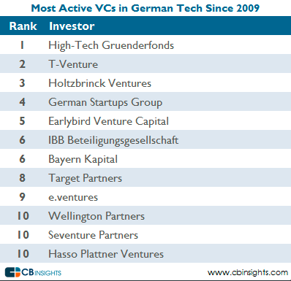
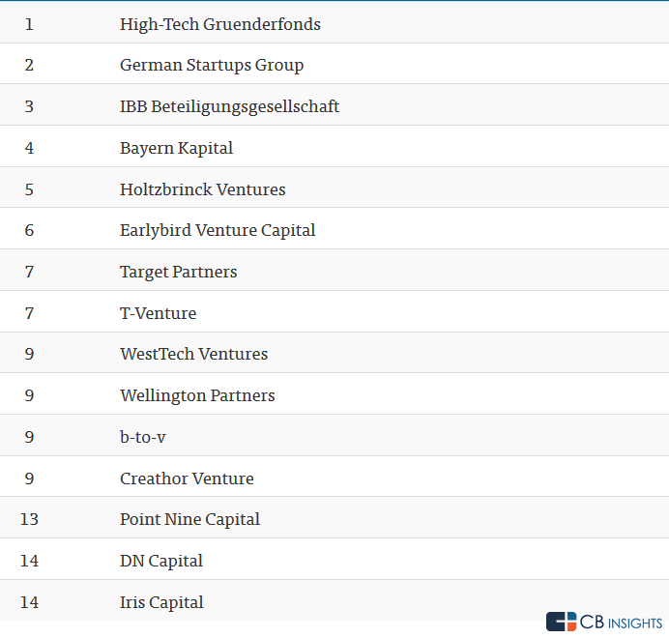

Slide 9
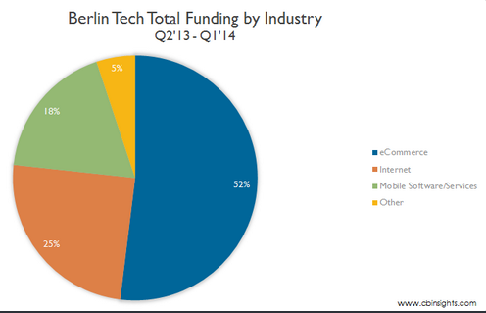
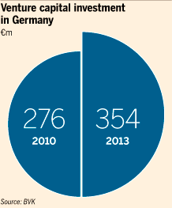
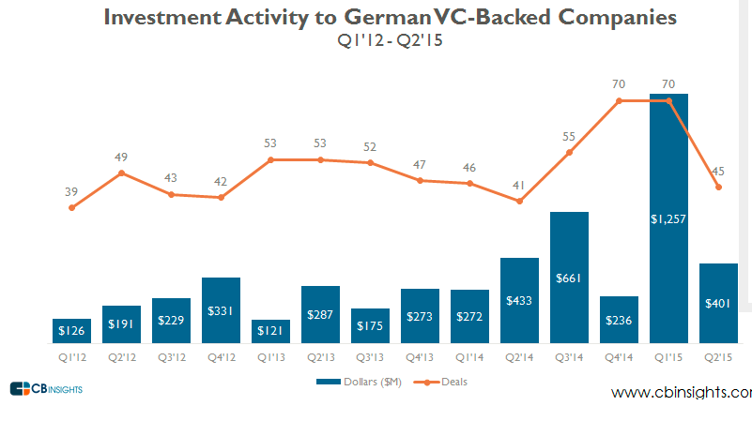

Slide 10
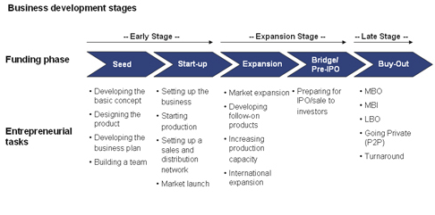
http://www.frankfurt-school.de/content/en/newsroom/sonnemann/newsletter_mae12/fokusthema_mae12/abstract_files/file/unternehmensphasen_en.jpg

Slide 11
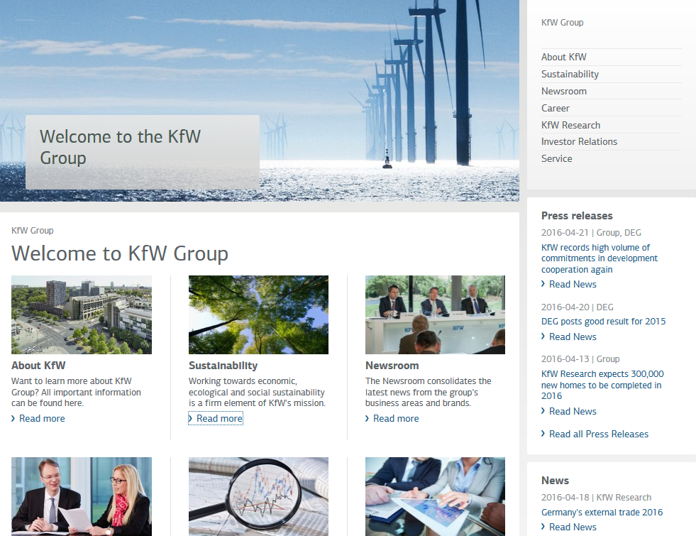

Slide 12
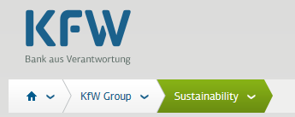
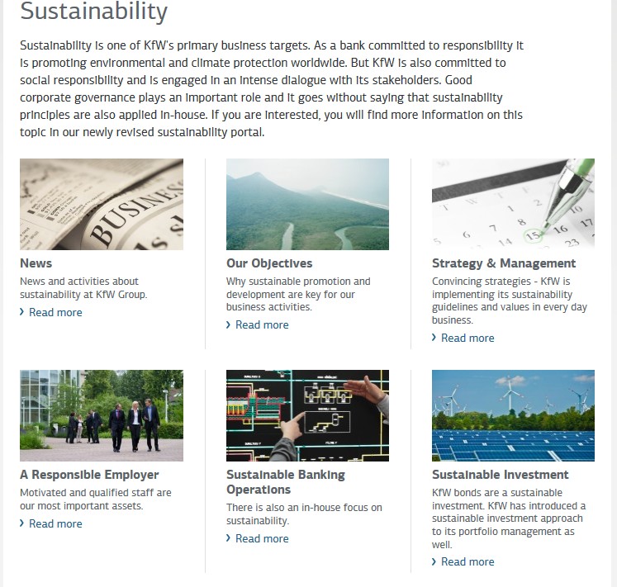
https://www.kfw.de/KfW-Group/

Slide 13
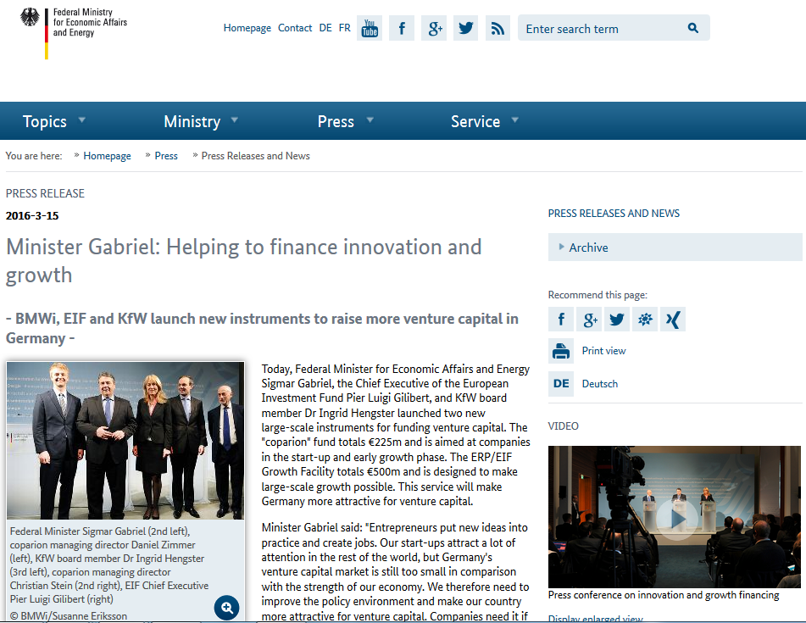

Slide 14
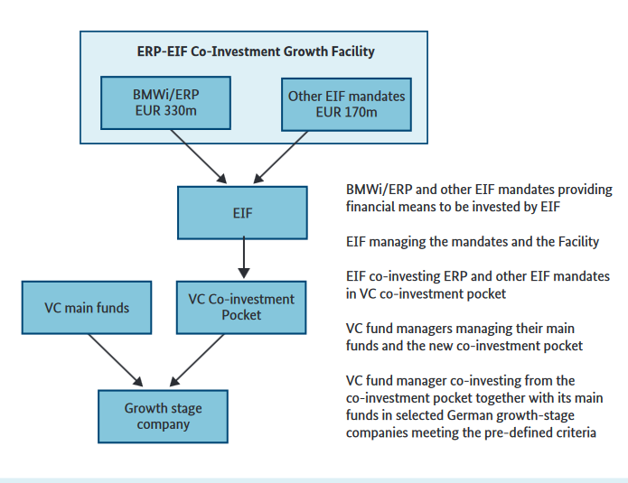
http://www.bmwi.de/English/Redaktion/Pdf/helping-to-finance-innovation-and-growth,property=pdf,bereich=bmwi2012,sprache=en,rwb=true.pdf

Slide 15
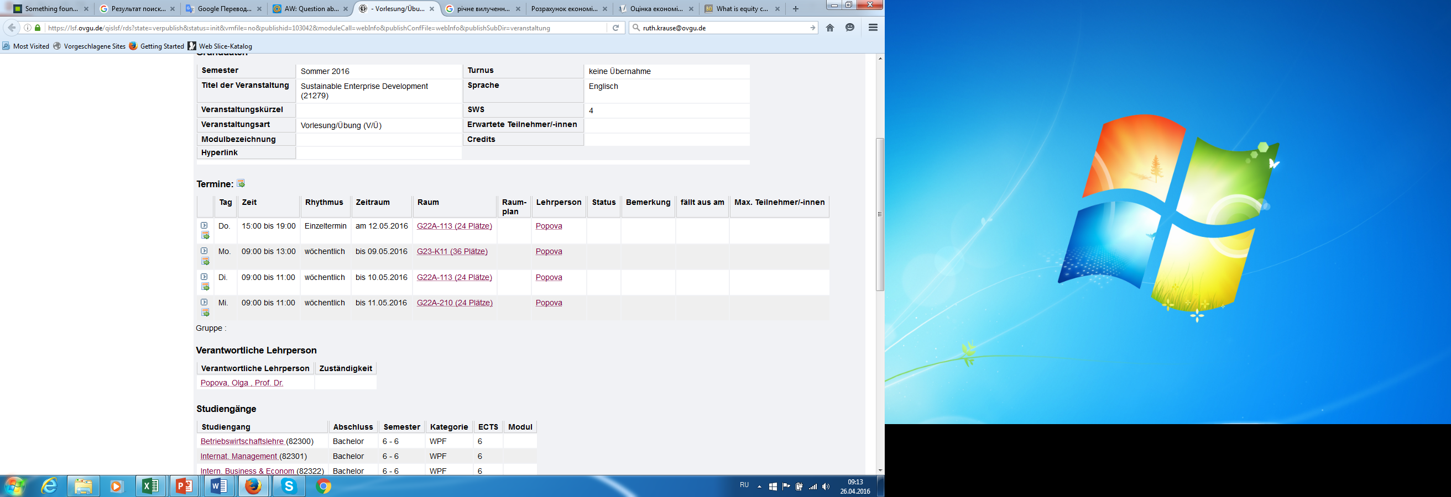

Slide 16
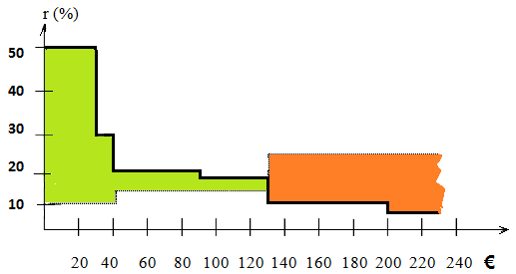
projects | Investment , thous. € | Investment Return | Сumulative sum | Sources of Capital | Supply of Capital, thous. € | Return on Capital | Сumulative sum
1 | 30 | 50 | 30 | 1 | 40 | 10 | 40
2 | 10 | 30 | 40
3 | 50 | 20 | 90 | 2 | 90 | 15 | 130
4 | 40 | 18 | 130
5 | 70 | 10 | 200 | 3 | 160 | 24 | 290
6 | 30 | 5 | 230 | 4 | 20 | 30 | 310

Slide 17
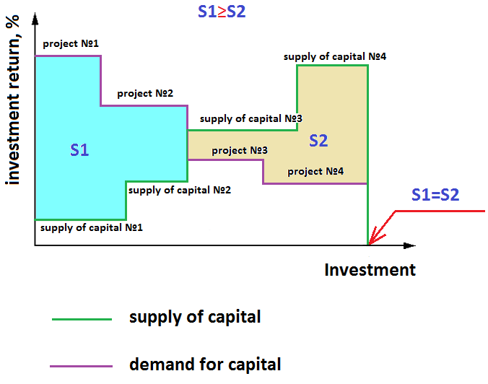

Slide 18
Decision Analysis on Inclusion the Project in the Program of Sustainable Enterprise Development
1. to rank the projects in order to descending rate of return
2. to rank investment in order to ascending rate of return
3. to build a polyline of supply and demand
4. visually to define the point of intersection
5. Define a system of equations depending on the point of intersection
6. Estimate the dates S1 and S2
7. Compare the dates S1 and S2
8. If S1 ≥ S2, E≥Emin then it is necessary to add the project j+1 to Program of SED and to determine the new date S2
9. If S1≤S2, E≤Emin, the review of another project is finished

Slide 19
Practice Example 1
Projects | Investment Return, % | Investment , thous. € | Return on Capital, % | Supply of Capital, thous. €
№ 1 | 0,51 | 6011 | 0,24 | 6400
№ 2 | 0,25 | 2213 | 0,26 | 2300
№ 3 | 0,18 | 2500 | 0,27 | 2600
№ 4 | 0,15 | 1565 | 0,29 | 1600

Slide 20
r
0,5
0,4
0,3
S1
0,2
S2
0,1
5000
10000
Investment, €
Supply
Demand
Е = S1-S2 = 4172,11-2930 = 1242,11 thous. €

Slide 21
Investment Plan
Periods Parameters (tous. €) | 0 | 1 | 2 | 3
Equity capital | 5000
Current Consumption | 0 | 0 | 0 | - 100
Recurring Investment Fees | -10000 | +5000 | +8000 | +3000
CALL DEPOSIT ACCOUNT: deposit commitment extinguish a deposit simple interests* |  |  | -7137,5 | +7137,5 +713,75
DEBT CAPITAL: operating credit redeem a credit simple interests ** | +5000 | +750 -5000 -750 | -750 -112,5
CURRENT VALUE OF PROJECT | 0 | 0 | 0 | +10751,25
* interest on deposits 10%
**interest rate 15%
Growth Of Capital=(10751,25- 5000)/5000*100%=115%

Slide 22
Practice Example 2
Projects |  | Periods
 |  | 0 | 1 | 2 | 3 | 4
Recurring Investment Fees (tous. €) | 1 | -1800 | 250 | 350 | 450 | 550
 | 2 | -1250 | -550 | 600 | 820 | 1100
Equity capital 1500 tous. €
Interest on deposits 5%
Interest rate 10%
Current Consumption 100 tous. €/year

Slide 23
Practice Example 3
Parameters | Existing Enterprise |  | New enterprise
 | Before reconstruction | After reconstruction
The volume of output, units | 20 000 | 30 000 | 10 000
Total costs, €/unit | 220 | 210 | 190
Price, €/unit | 300 | 300 | 300
Depreciation on Fixed Assets, €/year | 40 000 | 90 000 | 60 000
Capital Investment , € | - | 500 000 | 700 000
Risk Level, % | - | 6 | 9
Project Duration, years | 5
Value of Capital, % | 15
Profit tax, % Solidarity tax, % | 15 5,5

Slide 24

Net Present Value (NPV) is the difference between the present value of cash inflows and the present value of cash outflows. NPV is used in capital budgeting to analyze the profitability of a projected investment or project.
The following is the formula for calculating NPV:
where
Ct = net cash inflow during the period t
Co = total initial investment costs
r = discount rate, and
t = number of time periods

Slide 25
Calculation the NPV
 | Before reconstruction |  |  | + | New enterprise |  |  |  | After reconstruction
 | Ck=1386800 |  |  |  | Ck=985925 |  |  |  | Ck=2362725
k | (1+0,15)^{k} | 1/(1+0,15)^{k} | Ck*1/(1+0,15)^{k} |  | (1+0,24)^{k} | 1/(1+0,24)^{k} | Ck*1/(1+0,24)^{k} |  | (1+0,21)^{k} | 1/(1+0,21)^{k} | Ck*1/(1+0,21)^{k}
1 | 1,15 | 0,86956522 | 1205913,04 |  | 1,24 | 0,80645161 | 795100,806 |  | 1,21 | 0,82644628 | 1952665,29
2 | 1,3225 | 0,75614367 | 1048620,04 |  | 1,5376 | 0,6503642 | 641210,328 |  | 1,4641 | 0,68301346 | 1613772,97
3 | 1,520875 | 0,65751623 | 911843,511 |  | 1,906624 | 0,52448726 | 517105,103 |  | 1,771561 | 0,56447393 | 1333696,67
4 | 1,74900625 | 0,57175325 | 792907,401 |  | 2,36421376 | 0,4229736 | 417020,244 |  | 2,14358881 | 0,46650738 | 1102228,65
5 | 2,01135719 | 0,49717674 | 689484,697 |  | 2,93162506 | 0,34110774 | 336306,649 |  | 2,59374246 | 0,38554329 | 910932,769
 |  | SUM= | 4648768,69 |  |  | SUM= | 2706743,13 |  |  | Total SUM= | 6913296,34
 |  | Total SUM | 7355511,82
 |  | NPV = | 6655511,82 |  |  |  |  |  |  | NPV = | 6413296,34

Slide 26
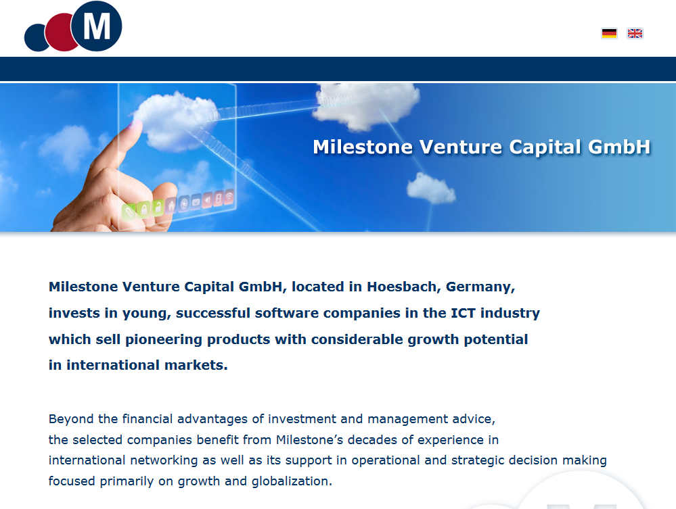

Slide 27
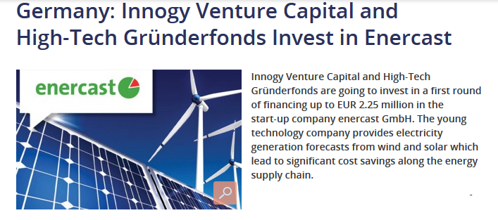
http://images.google.de/imgres?imgurl=http%3A%2F%2Fwww.offshorewind.biz%2Fwp-content%2Fuploads%2F2012%2F04%2FGermany-Innogy-Venture-Capital-and-High-Tech-Gr%2525C3%2525BCnderfonds-Invest-in-enercast.jpg&imgrefurl=http%3A%2F%2Fwww.offshorewind.biz%2F2012%2F04%2F23%2Fgermany-innogy-venture-capital-and-high-tech-grunderfonds-invest-in-enercast%2F&h=330&w=530&tbnid=zjtLWnKyskVElM%3A&docid=J4Xerll0iZIozM&itg=1&ei=JVkbV5esKobt6AT0lpDIBA&tbm=isch&iact=rc&uact=3&dur=770&page=4&start=92&ndsp=34&ved=0ahUKEwjX0p3o0KTMAhWGNpoKHXQLBEkQMwjmAShjMGM&bih=763&biw=1600

